Slide 1


I
I
Phase
TOAR-II Activities
Roeland Van Malderen¹, Herman G.J. Smit², Irina Petropavlovskikh^{3,4}, Thierry Leblanc⁵, Corinne Vigouroux⁶, Valérie Thouret⁷, Owen Cooper⁸, Kai-Lan Chang^{3,8}, Anne M. Thompson^{9,10}, Ryan M. Stauffer⁹, Debra E. Kollonige^{10,11}, Eliane Maillard Barras¹², Robin Bjorklund⁶, Peter Effertz⁴, Pawel Wolff¹³, Zhou Zang¹⁴, Jane Liu¹⁴, David W. Tarasick¹⁵, Daan Hubert⁶, Audrey Gaudel^{3,8}
¹Royal Meteorological Institute of Belgium, ²Forschungszentrum Jülich , ³CIRES, University of Colorado, ⁴NOAA Global Monitoring Laboratory, ⁵NASA Jet Propulsion Laboratory, California Institute of Technology, ⁶Royal Belgium Institute for Space Aeronomy, ⁷Laboratoire d'Aérologie, Université Toulouse III – Paul Sabatier, CNRS, ⁸NOAA Chemical Sciences Laboratory, ⁹NASA Goddard Space Flight Center,¹⁰GESTAR, University of Maryland, ¹¹Science Systems and Applications, Inc, Lanham ¹²Federal Office of Meteorology and Climatology MeteoSwiss, ¹³Observatoire Midi-Pyrénées, Université Toulouse III – Paul Sabatier, CNRS, ¹⁴Department of Geography and Planning, University of Toronto, ¹⁵Environment and Climate Change Canada
http://hegiftom.meteo.be/

Slide 2

TOAR-II Primary goals, 2020-2024
Tropospheric Ozone Assessment Report, Phase II
I
I
Phase
TOAR Database: Updated with all recent ozone observations worldwide; add ozone precursors and meteorological data.
Final Product: An observation-based assessment of tropospheric ozone’s distribution and trends on regional, hemispheric and global scales
(modelled after IPCC Working Group I)
Impact studies: will quantify the impacts of ozone on human health, vegetation and climate
(modelled after IPCC Working Group II)

Slide 3
TOAR-II Focus Working Groups
New research is being led by 16 independent Focus Working Groups:
Chemical Reanalysis Focus Working Group
East Asia Focus Working Group
Global and Regional Models Focus Working Group
HEGIFTOM Focus Working Group
Human Health Focus Working Group
Machine Learning for Tropospheric Ozone Focus Working Group
Ozone over the Oceans Focus Working Group
Ozone and Precursors in the Tropics (OPT) Focus Working Group
Ozone Deposition Focus Working Group
Radiative Forcing Focus Working Group
ROSTEES Focus Working Group
Satellite Ozone Focus Working Group
South Asia Focus Working Group
Statistics Focus Working Group
Tropospheric Ozone Precursors (TOP) Focus Working Group
Urban Ozone Focus Working Group
I
I
Phase

Slide 4
TOAR-II Focus Working Groups
New research is being led by 16 independent Focus Working Groups:
Chemical Reanalysis Focus Working Group
East Asia Focus Working Group
Global and Regional Models Focus Working Group
HEGIFTOM Focus Working Group
Human Health Focus Working Group
Machine Learning for Tropospheric Ozone Focus Working Group
Ozone over the Oceans Focus Working Group
Ozone and Precursors in the Tropics (OPT) Focus Working Group
Ozone Deposition Focus Working Group
Radiative Forcing Focus Working Group
ROSTEES Focus Working Group
Satellite Ozone Focus Working Group
South Asia Focus Working Group
Statistics Focus Working Group
Tropospheric Ozone Precursors (TOP) Focus Working Group
Urban Ozone Focus Working Group
I
I
Phase

Slide 5

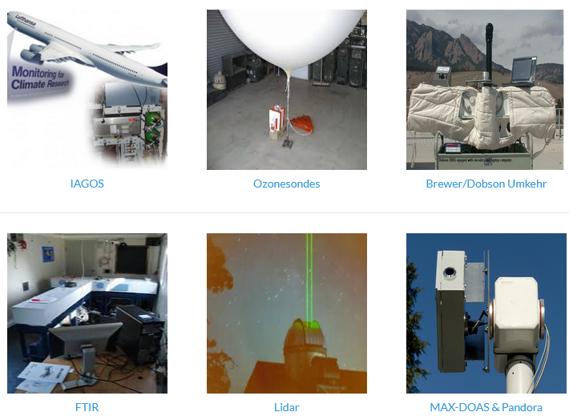
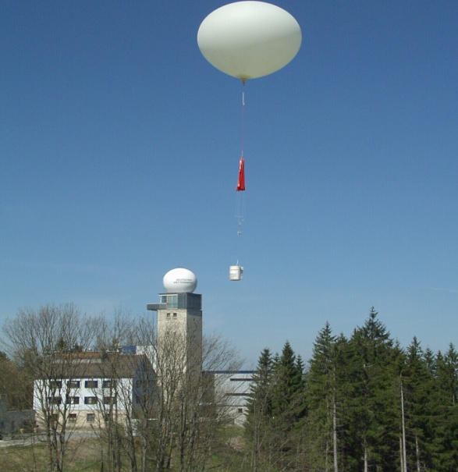
Introduction to TOAR-II Focus Working Group: HEGIFTOM
II
Harmonization and Evaluation of Ground-based Instruments for Free Tropospheric Ozone Measurements, chairs: Herman Smit & Roeland Van Malderen
Phase
Key Objective:
Evaluation and harmonization of the different free tropospheric ozone profiling datasets of the established measuring platforms (in-service aircraft, ozonesondes, Brewer/Dobson Umkehr, FTIR, Lidar).
Major Deliverable:
Quality assessed ozone data sets, whereby each measurement gets also an uncertainty and a quality flag. Thereby, representativeness and instrumental drifts will be characterized and evaluated.
http://hegiftom.meteo.be/datasets

Slide 6
Homogenized datasets and internal consistency
II
Achievements and updates:
Phase
IAGOS:
  internal consistency paper published in AMT (Blot et al., https://doi.org/10.5194/amt-14-3935-2021),
  simulation chamber comparison of IAGOS-CORE UV-photometer and reference photometer for ozonesondes (Smit et al., in preparation)
Lidar: TMF data has been updated with new data processor, OHP will follow
FTIR: flagging applied to the NDACC data
Brewer/Dobson Umkehr:
  6 Dobson Umkehr sites have been homogenized (Petropavlovskikh et al., https://doi.org/10.5194/amt-15-1849-2022)
  Updated uncertainty estimation of the retrievals.
ozonesondes:
  12 more sites homogenized, e.g. OHP, Lauder, Arctic sites (10-15/55 remaining)
  homogenized data available on ftp-server

Slide 7
Homogenized datasets
II
Deliverable: Homogenized free tropospheric ozone profile data, described at HEGIFTOM website, with same template for each dataset:
Phase
Availability
location (ftp, data archive, website, doi, e-mail address contact person, etc.).
Data field description
Measured data fields (and their units), incl. auxiliary data fields, available metadata. Data format
Description of homogenization procedure
short description of the steps taken to make the dataset (more) homogeneous within the network.
Data management
Flagging
Uncertainties
Traceability
Internal consistency
External consistency
Data quality indicators
List of homogenized sites (name, geographical location, period of observations)
https://hegiftom.meteo.be/datasets

Slide 8
Homogenized datasets
II
Deliverable: time series of different (partial) tropospheric ozone column amounts
Phase
  P > P_TP (WMO)
  P > P (lat) (e.g. 150 hPa @ tropics, 400 hPa in polar regions)
  P > 300 hPa
  FT: 4 < h < 8 km AND 700 hPa > P > 300 hPa
  LT: h < 4 km AND P > 700 hPa
  BL: h < 2 km
the 2 recommended TOAR-II tropospheric ozone column definitions
for all sites/techniques, if feasible
provided for all measurements (L1), together with daily means (L2) and monthly means (L3)
available in DU or ppb
uncertainties included (random, systematic, total, statistical)
simple csv files, with readme files per technique
https://hegiftom.meteo.be/datasets/tropospheric-ozone-columns-trocs

Slide 9
Intercomparisons
II
Deliverable: @ Lauder (Björklund et al., 2024), between IAGOS and sondes (Wang et al., 2024)
Phase

Slide 10
Intercomparisons
II
Deliverable: @ Lauder (Björklund et al., 2024), between IAGOS and sondes (Wang et al., 2024)
Phase

Slide 11
Tropospheric ozone column trends
II
TOAR-II: tropospheric ozone trends assessment
In literature:
Phase
Here: focus on high-quality ground-based and in-situ measurements (individual sites + “merged”)
Consistency in tropospheric ozone column metric (here: surface to 300 hPa)
Consistency in used trend estimation tools (QR vs. MLR)
Consistency in time ranges (here: 2000-2002 till 2019-2022)
Consistency in units (ppbv/dec)
Fig. 2.8 of
IPCC AR6, 2021.

Slide 12
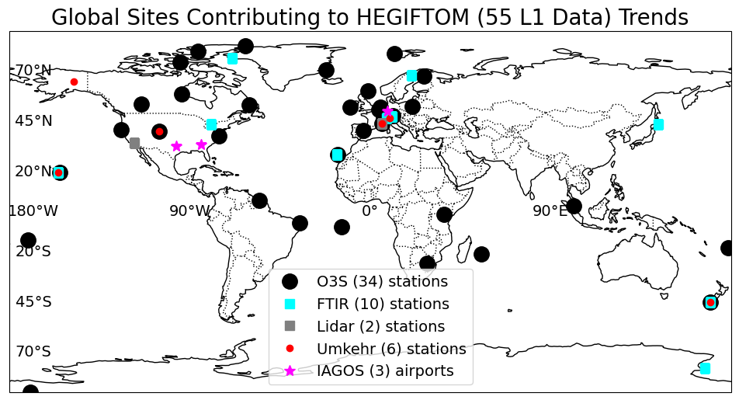
Individual site trends
II
Phase
Sampling and gaps put constraints
55 sites

Slide 13
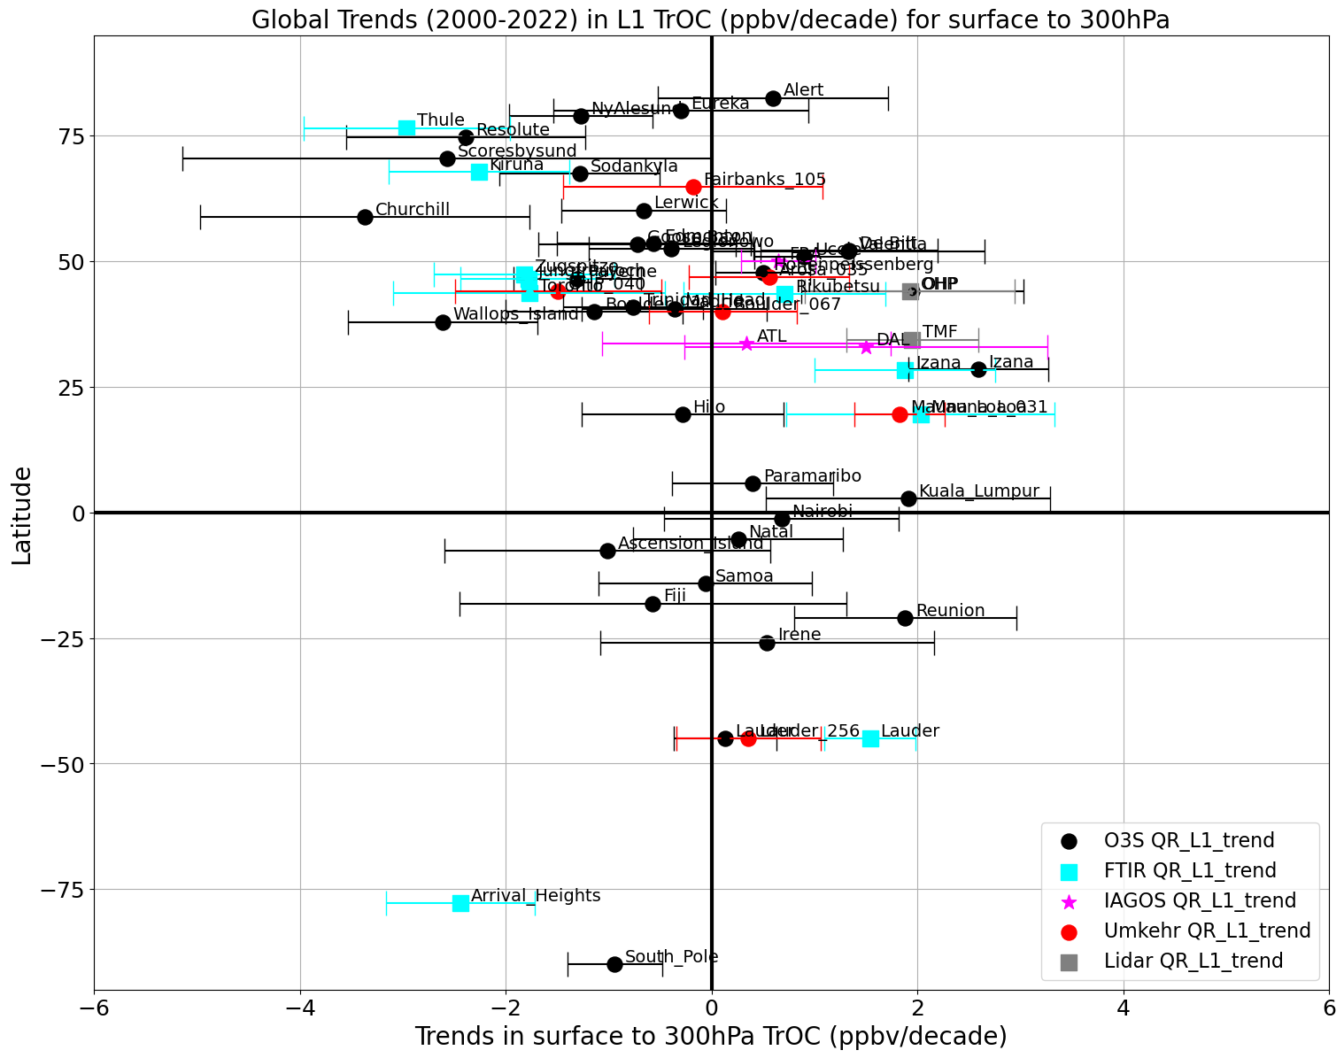
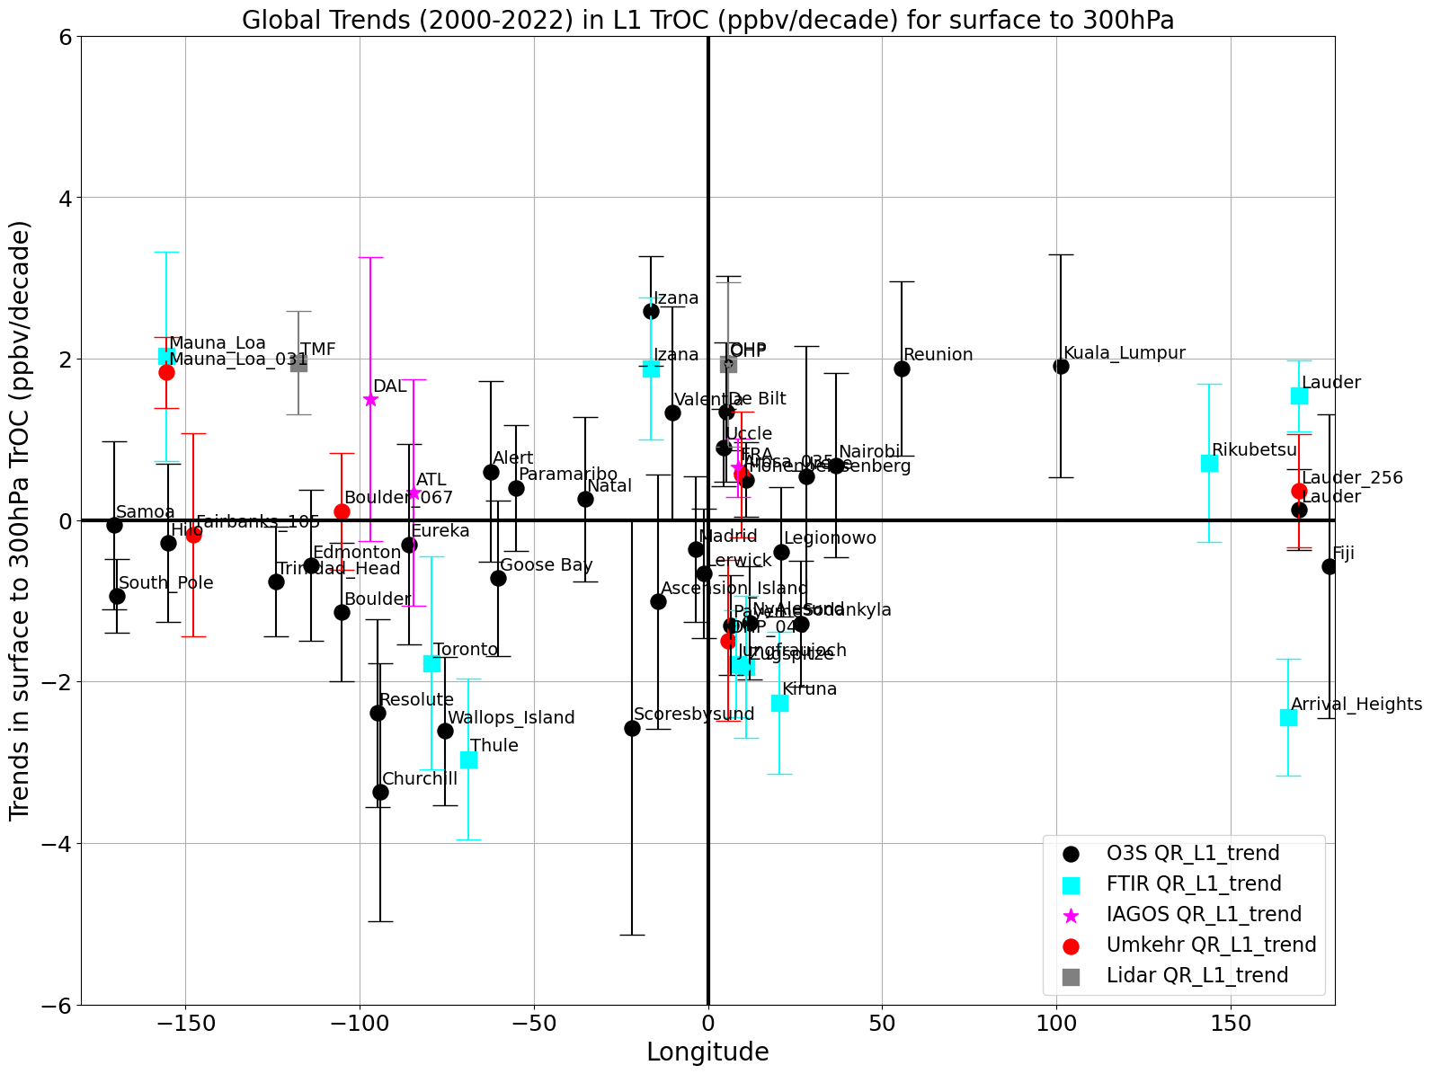
Individual site trends: QR median trends
II
Phase
see more results in Debra Kollonige’s talk tomorrow, Thursday!

Slide 14
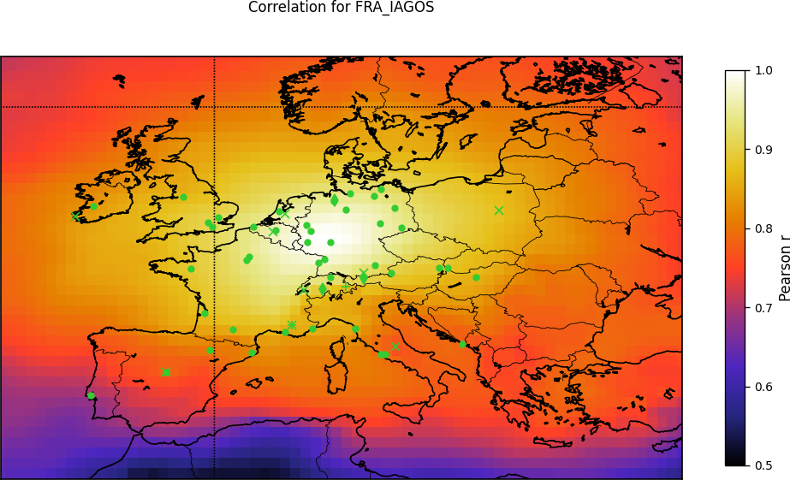
Strategy for regionalized trends
II
Phase
Correlation maps between CAMS TrOC (sfc – 300 hPa) monthly anomalies at HEGIFTOM sites (here: Frankfurt, IAGOS)
r > 0.7!
Frankfurt
1.
regions
2.
sites
Trends in defined regions with TOST (Trajectory-mapped Ozonesonde dataset for the Stratosphere and Troposphere): ozonesondes only!
→ Zang et al., accepted for ACP, 2024
Statistical method for calculating synthetized trends from well-correlated individual time series for all instruments, allowing an intercept and a slope to adjust the difference from each individual trend against the overall trends

Slide 15
All trends
II
Phase
background grey = individual site trends
different colors = different regions
open symbols = synthesized trends
filled symbols = TOST regional trends

Slide 16
All trends
II
Phase
background grey = individual site trends
different colors = different regions
open symbols = synthesized trends
filled symbols = TOST regional trends

Slide 17
Conclusions and outlook
II
Phase
without NDACC, no HEGIFTOM
HEGIFTOM data (O3S!!!) should feed back into NDACC
Tropospheric ozone distribution and trends with ground-based data really pushed to the limits: best (possible) effort done.
More results (post-COVID vs. pre-COVID, 1990/1995/2000 – 2022 trend comparisons, relative contribution of lower+free-tropospheric ozone column trends to entire tropospheric ozone column trends, TrOC seasonal cycle change, etc.):

Slide 18
Conclusions and outlook
II
Phase
More results:
  Debra Kollonige’s talk tomorrow
  Van Malderen et al., “Global Ground-based Tropospheric Ozone Measurements: Reference Data and Individual Site Trends (2000-2022) from the TOAR-II/HEGIFTOM Project” (working title), to be submitted to ACP (TOAR-II SI)
  Van Malderen et al., “Global Ground-based Tropospheric Ozone Measurements: Regional tropospheric ozone column trends from the HEGIFTOM homogenized ground-based profile ozone datasets” (working title), to be submitted to ACP (TOAR-II SI)

Slide 19






TOAR-II Community Special Issue
Focus Working Group findings submitted to the Community Special Issue in 2023-2024
An inter-journal special issue hosted by Copernicus

Slide 20
Tropospheric ozone column distribution
II
Phase
Mean column-averaged tropospheric ozone distribution (TrOC) from surface – 300 hPa for 2000-2022
Lowest: tropics (< ±15°) and SH; Highest: NH (spring & summer!)
Reason: ozone production from enhanced anthropogenic emissions in the NH and higher rates of stratospheric downwelling
[ppb]
ozonesondes
Umkehr
FTIR
IAGOS
Lidar

Slide 21
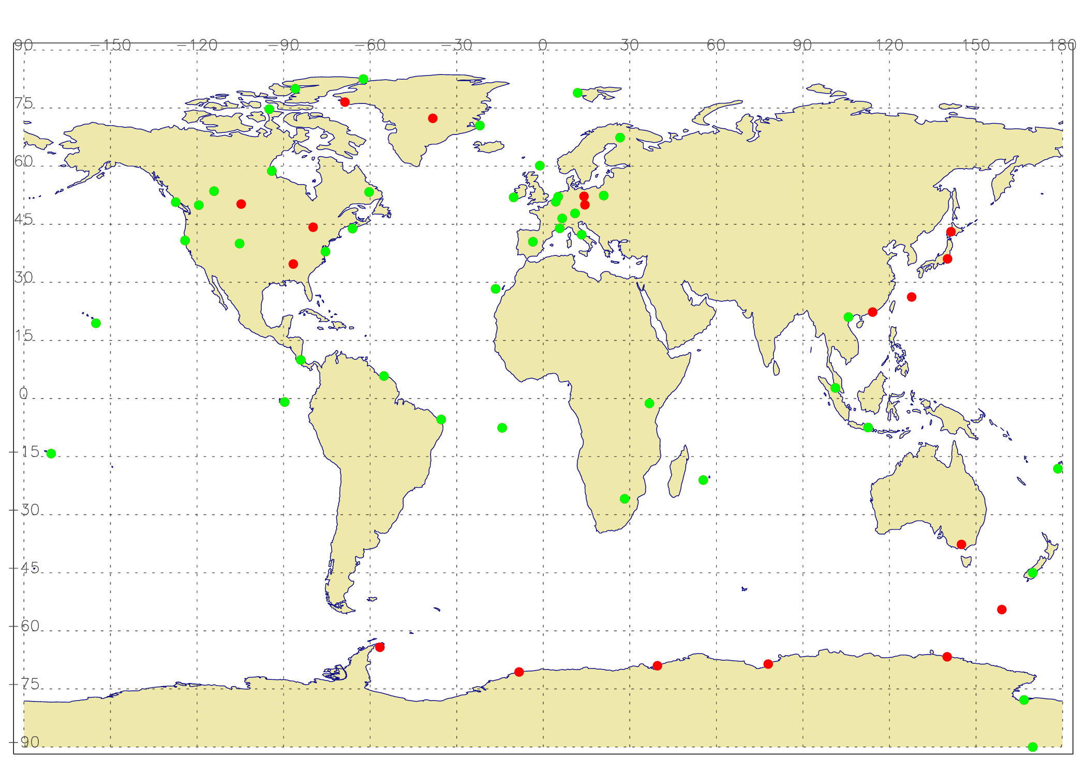
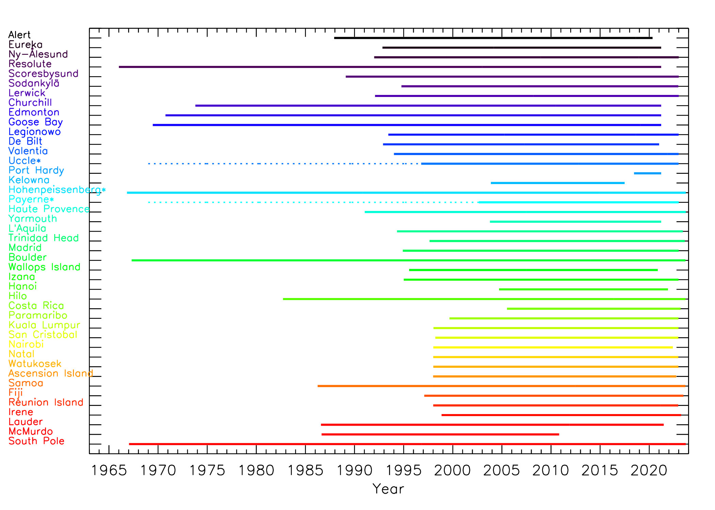

Homogenized datasets: e.g. ozonesondes
II
Phase
43 sites (green dots) with homogenized ozone profile data
similar plots and data description (one common template) for the other techniques!
see e.g. poster 6-49
https://hegiftom.meteo.be/datasets/ozonesondes

Slide 22
Tropospheric ozone column distribution: COVID impact
II
Phase
Relative change of mean TrOC for the time period 2020-2022 vs. 2000-2019 Blue: 2020-2022 < 2000-2019 Red: 2020-2022 > 2000-2019
Decline in 75% of the sites, on average -2.5% prominent in NH (spring + summer), stronger in FT.
Impact on trends!
ozonesondes
Umkehr
FTIR
IAGOS
Lidar

