Slide 1
Towards a Portal to Atmospheric and Marine Information Resources
(PAMIR)
Anne De Rudder, Jean-Christopher Lambert
Belgian Institute for Space Aeronomy (IASB-BIRA)
Serge Scory, Myriam Nemry
Royal Belgian Institute of Natural Sciences (RBINS)
Roeland Van Malderen, Laurent Delobbe
Royal Meteorological Institute of Belgium (RMIB)

Slide 2
Objective
PAMIR is a BRAIN-be
(Belgian Research Action through Interdisciplinary Networks)
2-year project (2014-2016)
to explore and develop generic concepts related to the
description,
documentation,
classification,
quality assurance
of atmospheric and oceanographic data of the Belgian federal portfolio, in compliance with international standards and practice, including the INSPIRE Directive.

Slide 3
Key milestones
Validation protocol. Design of a generic validation, evaluation and quality control protocol, virtually applicable to any data of the federal portfolio of atmospheric and oceanographic information, and including aspects specific to each scientific domain.
Support to validation reporting. Design of a generic validation report template to support data validation reporting.
Metadata model. Design of a common metadata model suited to the documented scientific datasets and compatible with the latest INSPIRE Metadata and Interoperability Regulations.
Metadata editor. Design and development of a metadata editor based on the previous.
Web portal incl. catalogue. Set up of a centralized portal prototype offering a dataset catalogue (underpinned by the above metadata model) as well as online information on data validation and model evaluation.

Slide 4
PAMIR and INSPIRE
INSPIRE Annex III relevant data themes:
N° 7 – Environmental monitoring
N° 13 – Atmospheric conditions
N° 14 – Meteorological geographical features
N° 15 – Oceanographic geographical features
N° 16 – Sea regions
N° 20 – Energy resources (hydropower, solar, wind)
PAMIR fits into the INSPIRE endeavour: harmonisation of metadata and ease of data search and exchange.
PAMIR will contribute to help integration of Belgian federal Earth science data collections into the INSPIRE network... and may contribute to further shaping of INSPIRE?
Related project: INITGeoBe (set up of an INSPIRE Belgian national portal).

Slide 5
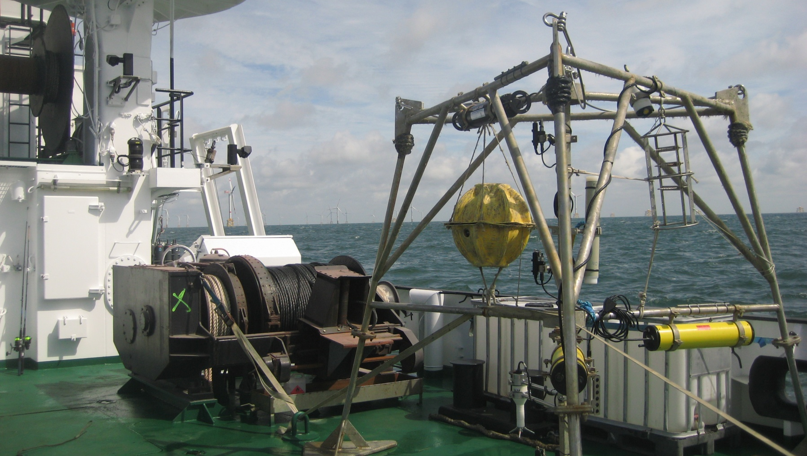
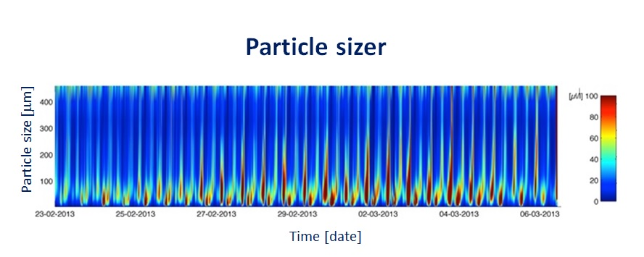
Example of use case data - Ocean
Current profler
Particle sizer
Passive sampler
Passive Cetacean monitor system
Turbidity meter
Temperature & Conductivity meter
Current meter

Slide 6
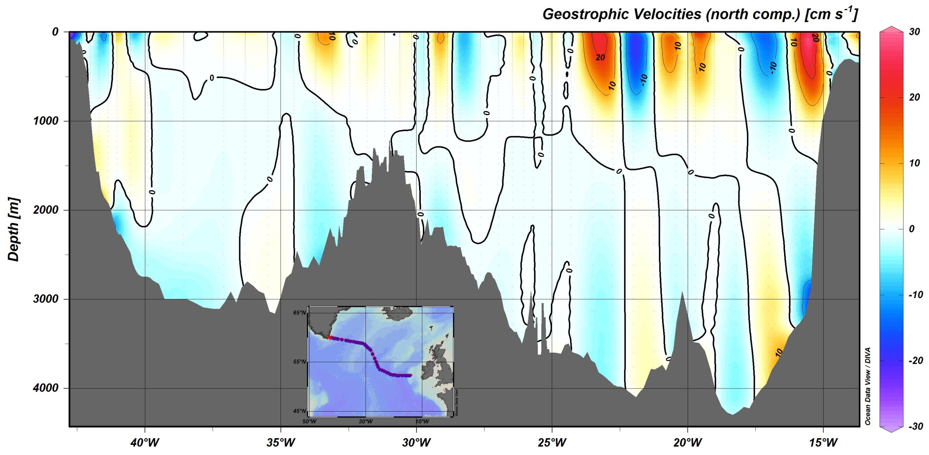
Example of ocean data along cruise path
Longitude [deg W]
Courtesy Schlitzer, Reiner, Ocean Data View, http://odv.awi.de, 2014.

Slide 7
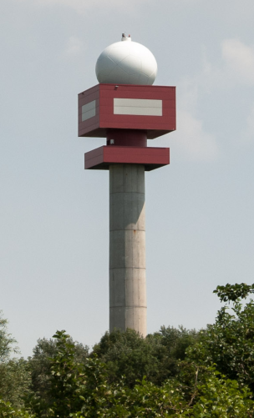
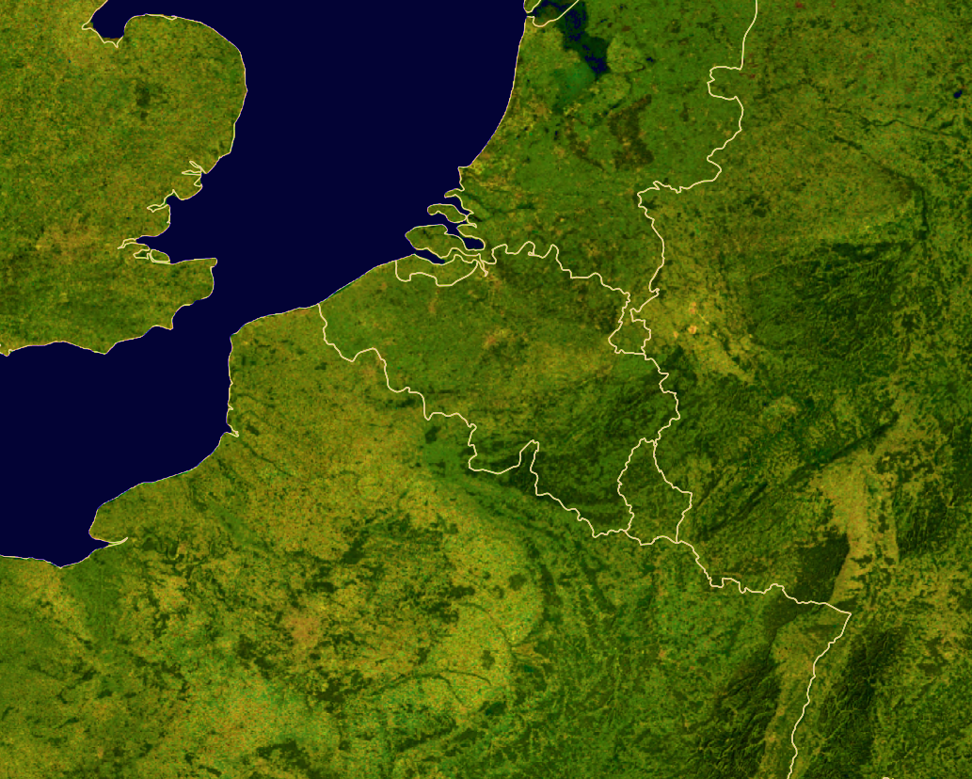
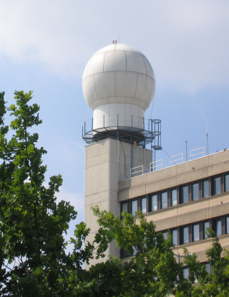
Example of use case data - Meteorology
Belgian radar network
Jabbeke
RMI
Selex, 2-pol
Wideumont
RMI
Selex, 1-pol
Zaventem
Belgocontrol
Radtec-Sigmet, 1-pol

Slide 8
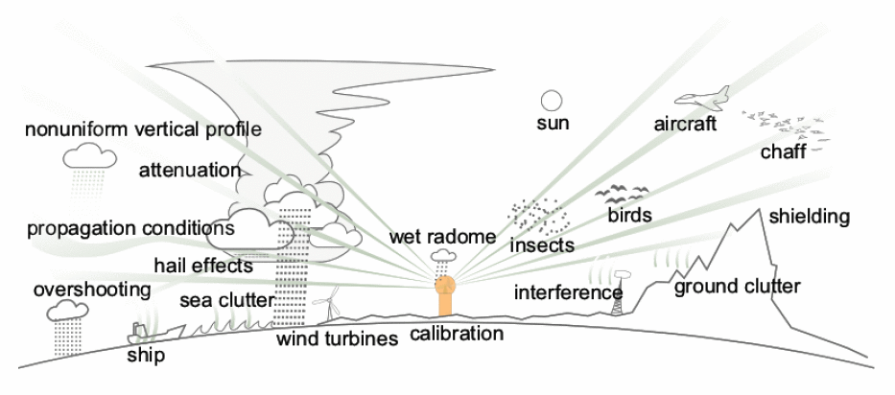
Example of use case data - Meteorology
Raw Radar Data
reflectivity & radial velocity
Single
Radar Images
Wind
Profile
Composite
Radar Images
Daily & Hourly
Precipitation Accumulations
Sliding
Accumulations
Specialized
Products
Basin-averaged Precipitation Accumulation
Real-Time
Return Period
Echotop
Hail
Detection
From Daniel Michelson (SMHI)

Slide 9
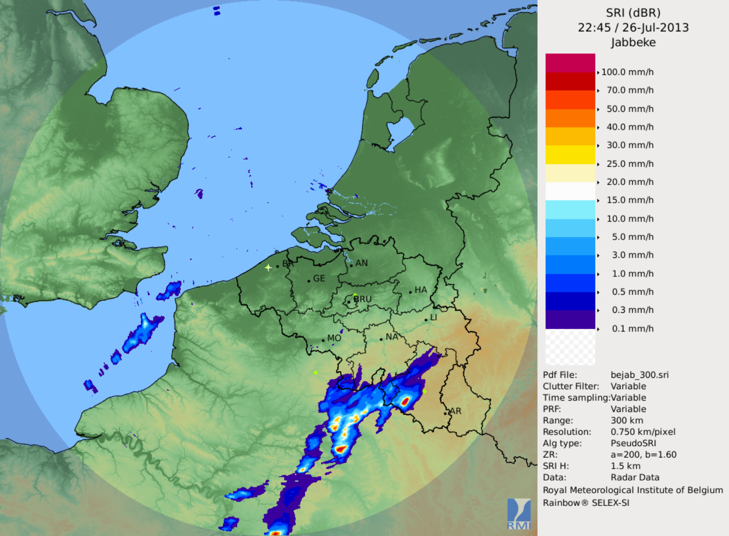
Example of use case data - Meteorology
Convective storm cell
8 km
B
Altitude
A
2 km
A
B
Courtesy Maryna Lukach,
RMI

Slide 10
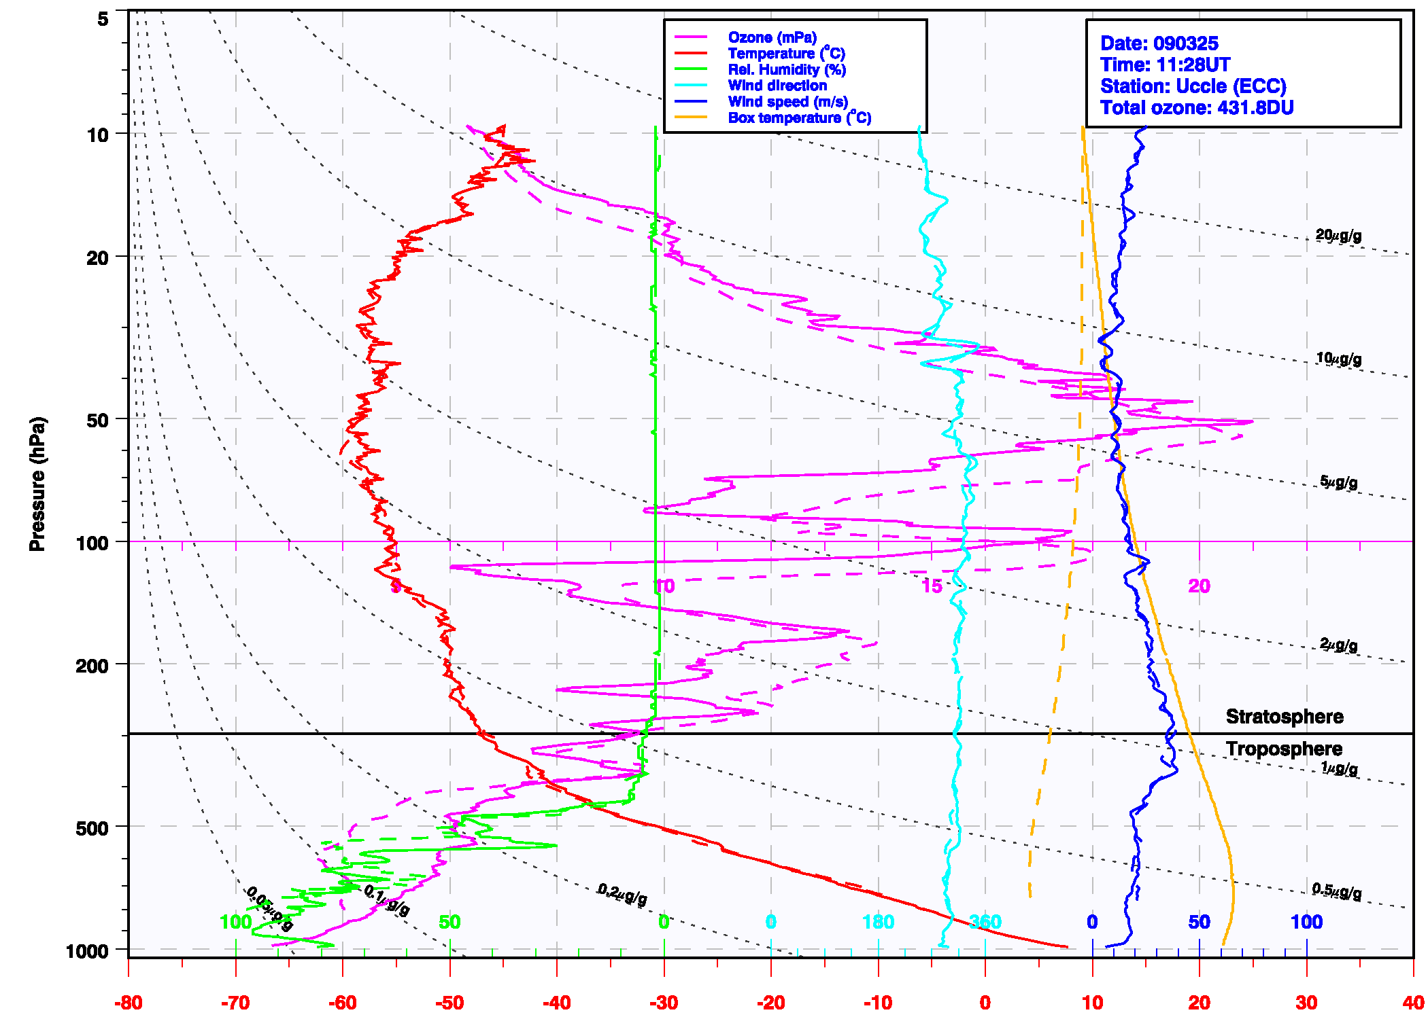
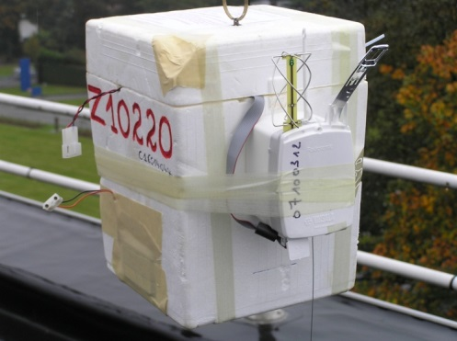
Example of use case data - Meteorology
Ozone and radiosonde vertical profiles of T, p, RH, O₃, wind v, wind dir
Pressure (hPa)
ozonesonde
radiosonde

Slide 11
Data Sets Acquired/Generated by BIRA-IASB
1. Atmospheric composition data from ground-based observations
NDACC zenith-sky UV-visible DOAS spectrometers (stratosphere)
MAX-DOAS UV-visible spectrometers (troposphere)
NDACC/TCCON FTIR spectrometers
2. Atmospheric composition data from satellite observations
In-house retrieval of ERS-2 GOME, Envisat SCIAMACHY, Aura OMI, MetOp-A/B GOME-2 and IASI, and in the future, Sentinel-5p TROPOMI...
Ozone (O₃), nitrogen dioxide (NO₂), formaldehyde (HCHO), glyoxal (CHOCHO), bromine monoxide (BrO), chlorine dioxide (OClO), sulfur dioxide (SO₂), aerosols (IASI)
3. UV radiation data from ground-based observations
Belgian network of UV monitoring stations

Slide 12
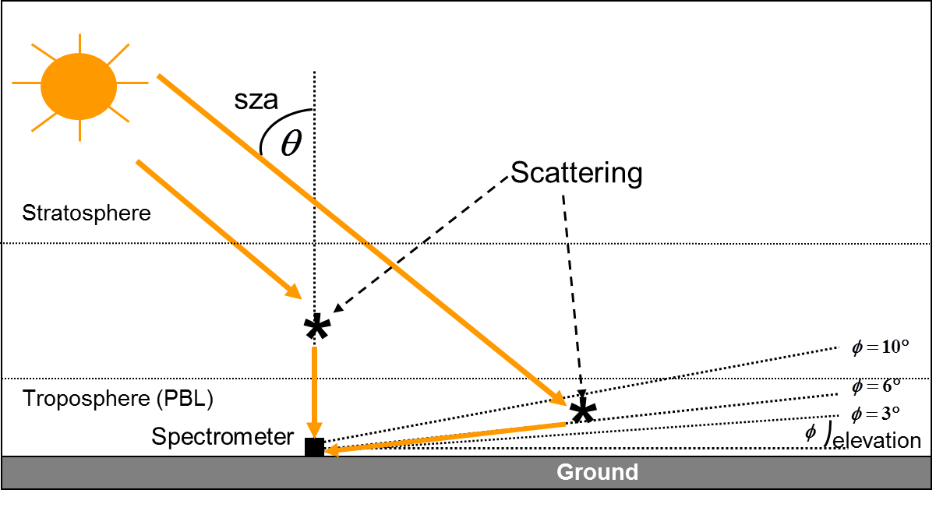
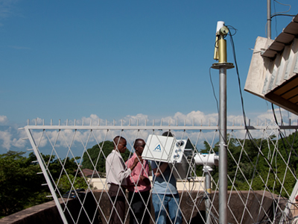
Example of use case data - Aeronomy
Ground-based MAX-DOAS UV-visible spectrometers
http://uv-vis.aeronomie.be
Retrieved gases
Ozone (O₃)
Nitrogen dioxide (NO₂)
Bromine monoxide (BrO)
Chlorine dioxide (OClO)
Formaldehyde (CH₂O)
Glyoxal (CHOCHO)
Sulfur dioxide (SO₂)

Slide 13
Example of use case data - Aeronomy
Examples of MAX-DOAS HCHO and NO₂ retrievals at Xianghe (Beijing area)
A priori profile:
with SH = 0.5km
From M. Van Roozendael et al.

Slide 14
The “D-challenge”
The space in which atmospheric and ocean phenomena are observed and in which data are measured (or modelled) has 4 equally important dimensions (“independent variables”):
longitude and latitude (“recognised” dimensions in the INSPIRE relevant thematic data specifications)
the vertical (depth, altitude, pressure, potential temperature, …)
time
In INSPIRE data models, the last two types of coordinates may be added as attributes to the data, which gives them an utterly different role as the one of geographical coordinates and does not allow a proper representation of an Earth science generic dataset.

Slide 15
With ocean and atmosphere, let INSPIRE gain altitude and depth.
PAMIR will not directly tackle the issue of the data models, but
these reflect on the metadata definition, which falls into the project realm;
at some point, the datasets will have to become fully INSPIRE-compliant.
… the solution : a new fully 4-D data model?

Slide 16
Quality
What quality information does a user of ocean/atmospheric data need in order to be able to assess whether the data are fit for his/her purpose?
Description of product derivation chain (traceability of data)
Existence of quality assessment
Validation method & description of validation chain (traceability of validation)
Information on validation datasets (reference data used for comparison)
Quality indicators (e.g. uncertainty, quality flags)
Analysis of validation results
Data information content analysis
The provision of quality indicators (QI) and the « traceability to international standards » such as SI (for units) are central requirements of the GEO’s QA4EO framework endorsed by the CEOS.
GEO : Group on Earth Observation
QA4EO : Quality Assurance Framework for Earth Observation - http://qa4eo.org/
CEOS : Committee on Earth Observation Satellites

Slide 17
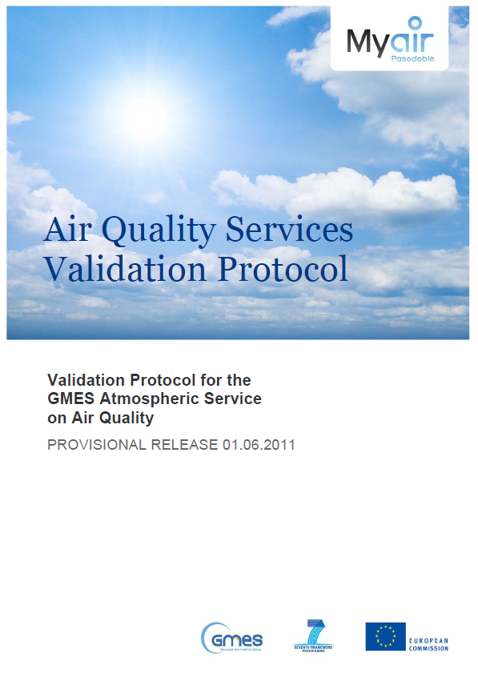
Validation protocols

Slide 18
Validation protocols
General principles
ALGORITHM AND PRODUCT DEVELOPMENT
Documented & traceable QI (QA4EO core requirement)
Analysis of information content
Confrontation with independent reference data
Error budget
RESEARCH
AGAINST
PARTNERS
VALIDATION OF
INDIVIDUAL COMPONENTS
IMPLEMENTATION AND OPERATIONALISATION
SYSTEM
FEEDBACK
DEVELOPERS
VALIDATION AGAINST
SPECIFICATIONS
Specifics, for example:
OPERATION
GHG & RG
AQ forecasts & assessments
O₃, solar UV radiation & indices
Aerosol & PM
Wild fire emissions & volcano outgassing
Alerts & fast response
ENDORSEMENT
CORE USERS
VALIDATION AGAINST
USER REQUIREMENTS
UTILISATION
SERVICE
PROVIDERS
QUALITY ASSESSMENT /
QUALITY CONTROL
SERVICE UPDATES AND EXTENSION

Slide 19
End-to-end validation of retrieval chain

Slide 20
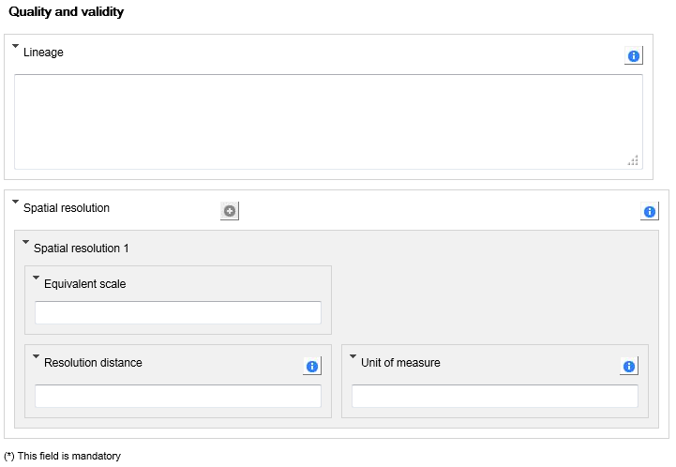
INSPIRE geoportal metadata editor
The only field where information on quality may be provided (together with elements of information of different natures)
The identification of horizontal resolution with data quality is an issue

Slide 21
PAMIR metadata editor
PAMIR
online
catalogue
Metadata online interactive input
Ingestion of metadata (xml) file
complete xml file
file
processor
editor
Retrieval from data file header
INSPIRE compliant xml file
INSPIRE
metadata
editor
/
verificator

Slide 22
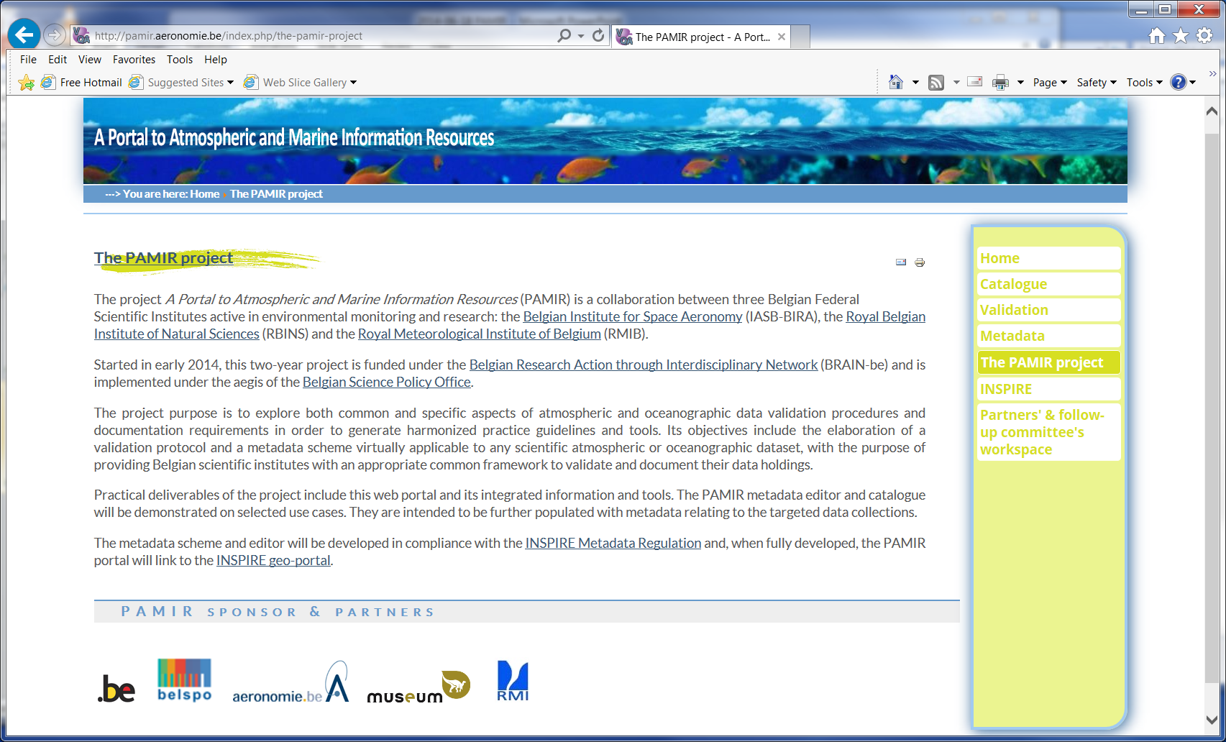
http://pamir.aeronomie.be/

Slide 23
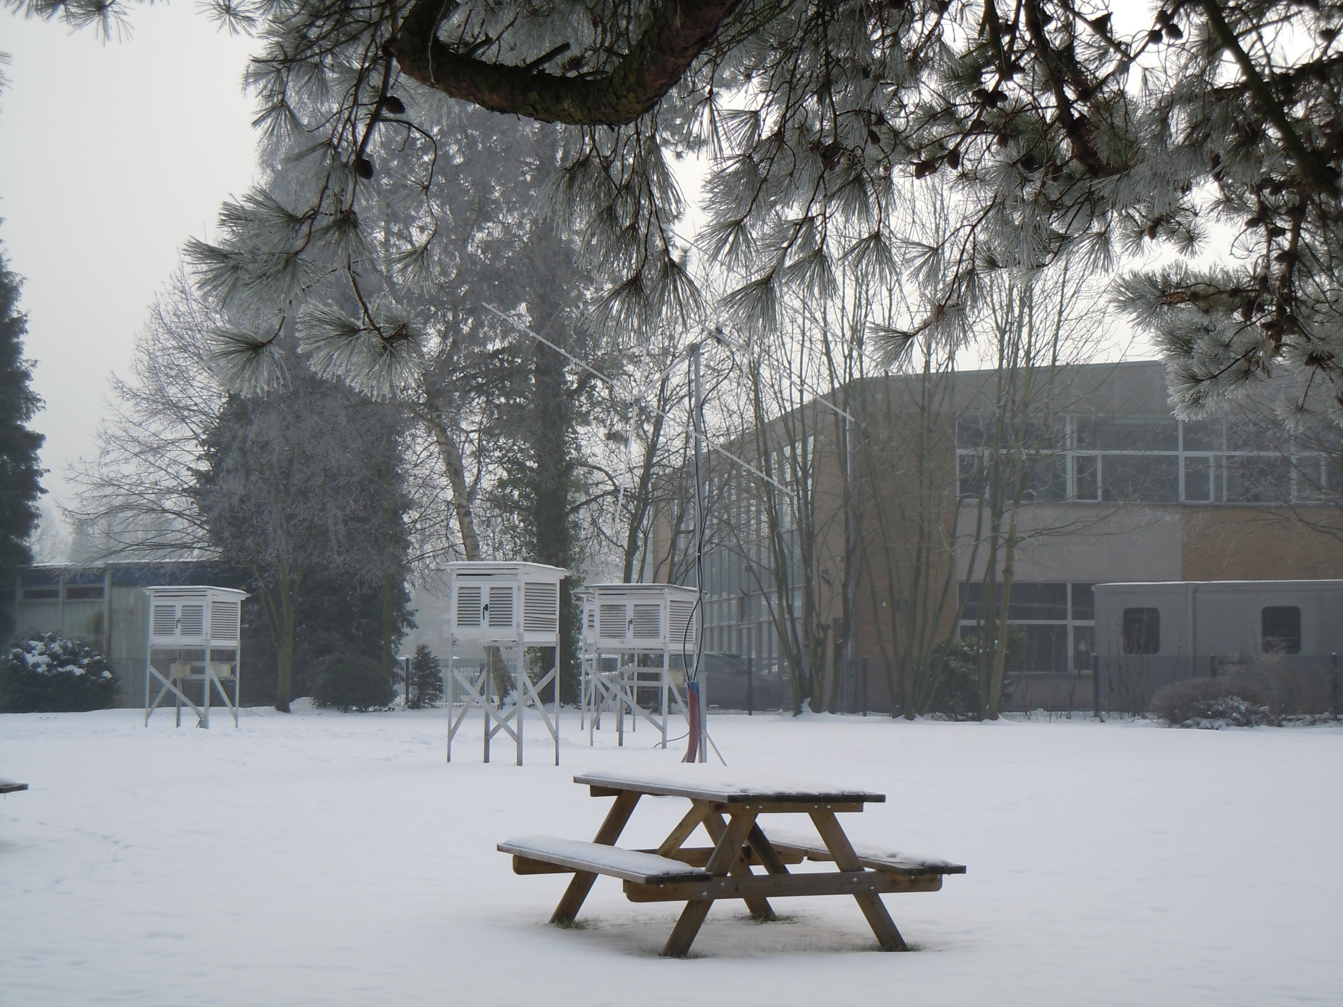
Thank
you

