Slide 1

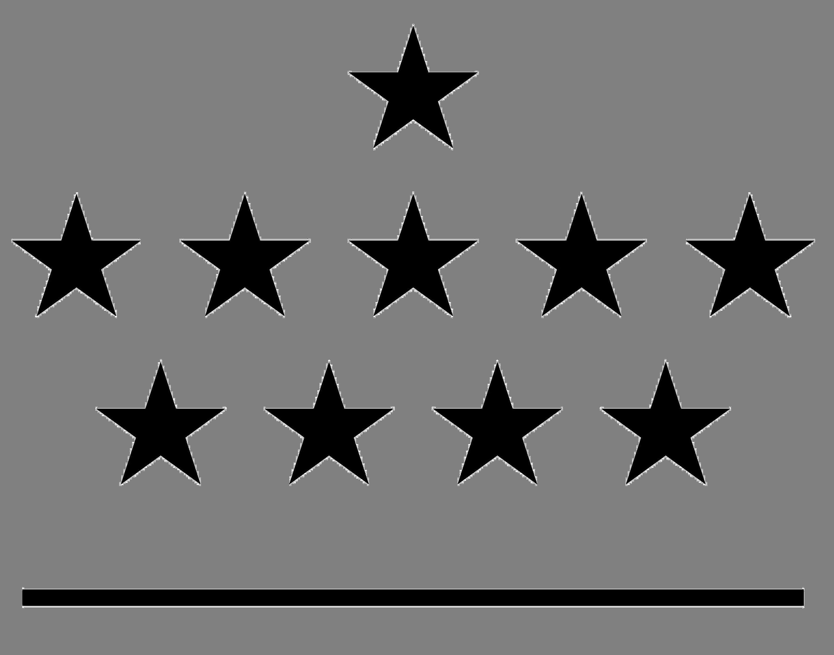


Evaluating satellite retrievals of Integrated Water Vapour (IWV) data by co-located ground-based devices for climate change analysis
Royal Meteorological
Institute of Belgium
Belgian Institute
for Space Aeronomy
Royal Observatory of Belgium
Max Planck Institute
for Chemistry
Solar-Terrestrial Centre of Excellence
1
2
3
4
5
R. Van Malderen^{1,5}, H. Brenot², E. Pottiaux^{3,5}, S. Beirle⁴, C. Hermans², M. De Mazière², T. Wagner⁴, H. De Backer¹, and C. Bruyninx³

Slide 2




Outline
ROB
Instruments and datasets
Sensitivity analysis of selection criteria
  Day-night differences in AIRS
  Homogeneity of GOMESCIA
  Impact of cloud cover
Spatio-temporal variations
  Geographical variations
  Seasonal variation
Conclusions
EUMETSAT/AMS conf. Vienna, 16-20 Sept. 2013

Slide 3

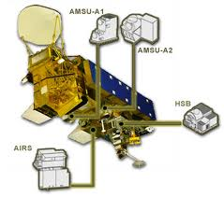

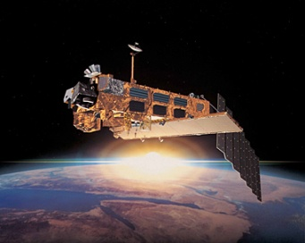
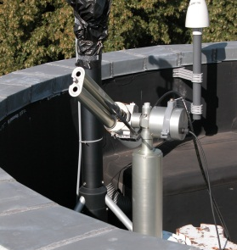
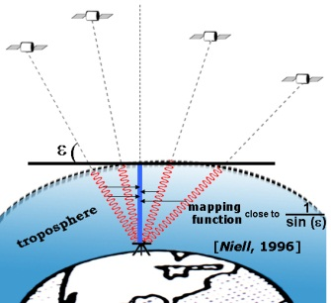
Instruments & datasets
Sensitivity analysis
Spatio-temporal variations
Conclusions
ROB
GOME/SCIAMACHY/GOME-2
AIRS
total column water vapour
CIMEL sun photometer
GPS
radiosondes
EUMETSAT/AMS conf. Vienna, 16-20 Sept. 2013

Slide 4
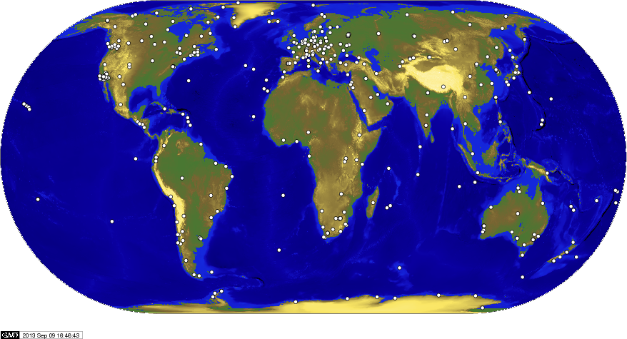
Instruments & datasets
Sensitivity analysis
Spatio-temporal variations
Conclusions
ROB
Ground-based device
GNSS/GPS
International GNSS Service (IGS) database (homog. reprocessing 1995-2011)
at all weather conditions, always
high time frequency (every 5 minutes)
T_{s} and p_{s} are needed: Zenith Total Delay → IWV
EUMETSAT/AMS conf. Vienna, 16-20 Sept. 2013
The IGS network of GPS stations

Slide 5
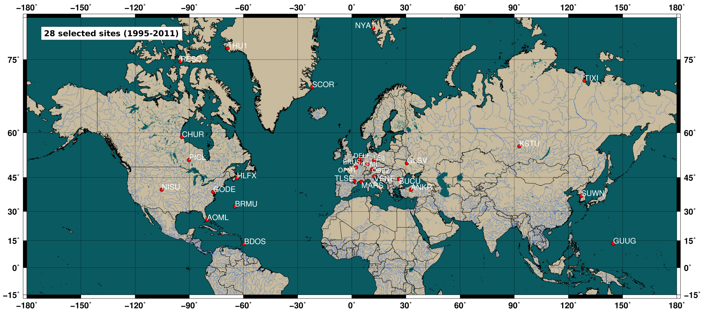
Instruments & datasets
Sensitivity analysis
Spatio-temporal variations
Conclusions
ROB
selection of 28 sites world-wide (NH), with focus on CIMEL-GPS co-location and based on meteo data availability (GPS)!
EUMETSAT/AMS conf. Vienna, 16-20 Sept. 2013

Slide 6
Instruments & datasets
Sensitivity analysis
Spatio-temporal variations
Conclusions
ROB
Satellite devices
AIRS
Atmospheric InfraRed Sounder on board Aqua
operates in the wavelength range 3.7 to 15 μm
JPL/NASA retrieval method
pixel size: ellipsoidal, with major axis varying from 13.5 km (at nadir) to 31.5 km
IWV calculated from cloud-cleared radiances
data available from 2002 - now
GOME/SCIAMACHY/GOME-2
air mass corrected differential optical absorption spectroscopy method applied to nadir measurements from 608-680 nm
MPI-C retrieval method
pixel size: 40 km×320 km (GOME), 30 km×60 km (SCIAMACHY), and 40 km×80 km (GOME-2)
cloud cover is an issue
data available from 1995 – now
EUMETSAT/AMS conf. Vienna, 16-20 Sept. 2013

Slide 7
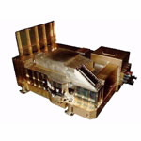
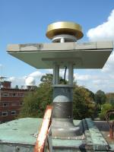
Instruments & datasets
Sensitivity analysis
Spatio-temporal variations
Conclusions
ROB
STEP 1: all overpass measurements → 1 value
AIRS
Δt = 30 minutes
d < 50 km between ground pixel centre and GPS
Qual_H2O = 0 or 1 (p_{best}=p_{surf} or < 300hPa)
GOMESCIA
Δt = 30 minutes
GPS station in ground pixel kkkkkkkkkkkkkkkkk
normalized O₂ absorption > 1
distance ↘ → correlation ↗
cloud flag criteria are necessary for “reasonable” correlations!
GPS
STEP 2: sensitivity analysis of the selection criteria
STEP 3: geographical and seasonal dependency STEP 3: of GPS-satellite IWV correlations
EUMETSAT/AMS conf. Vienna, 16-20 Sept. 2013

Slide 8
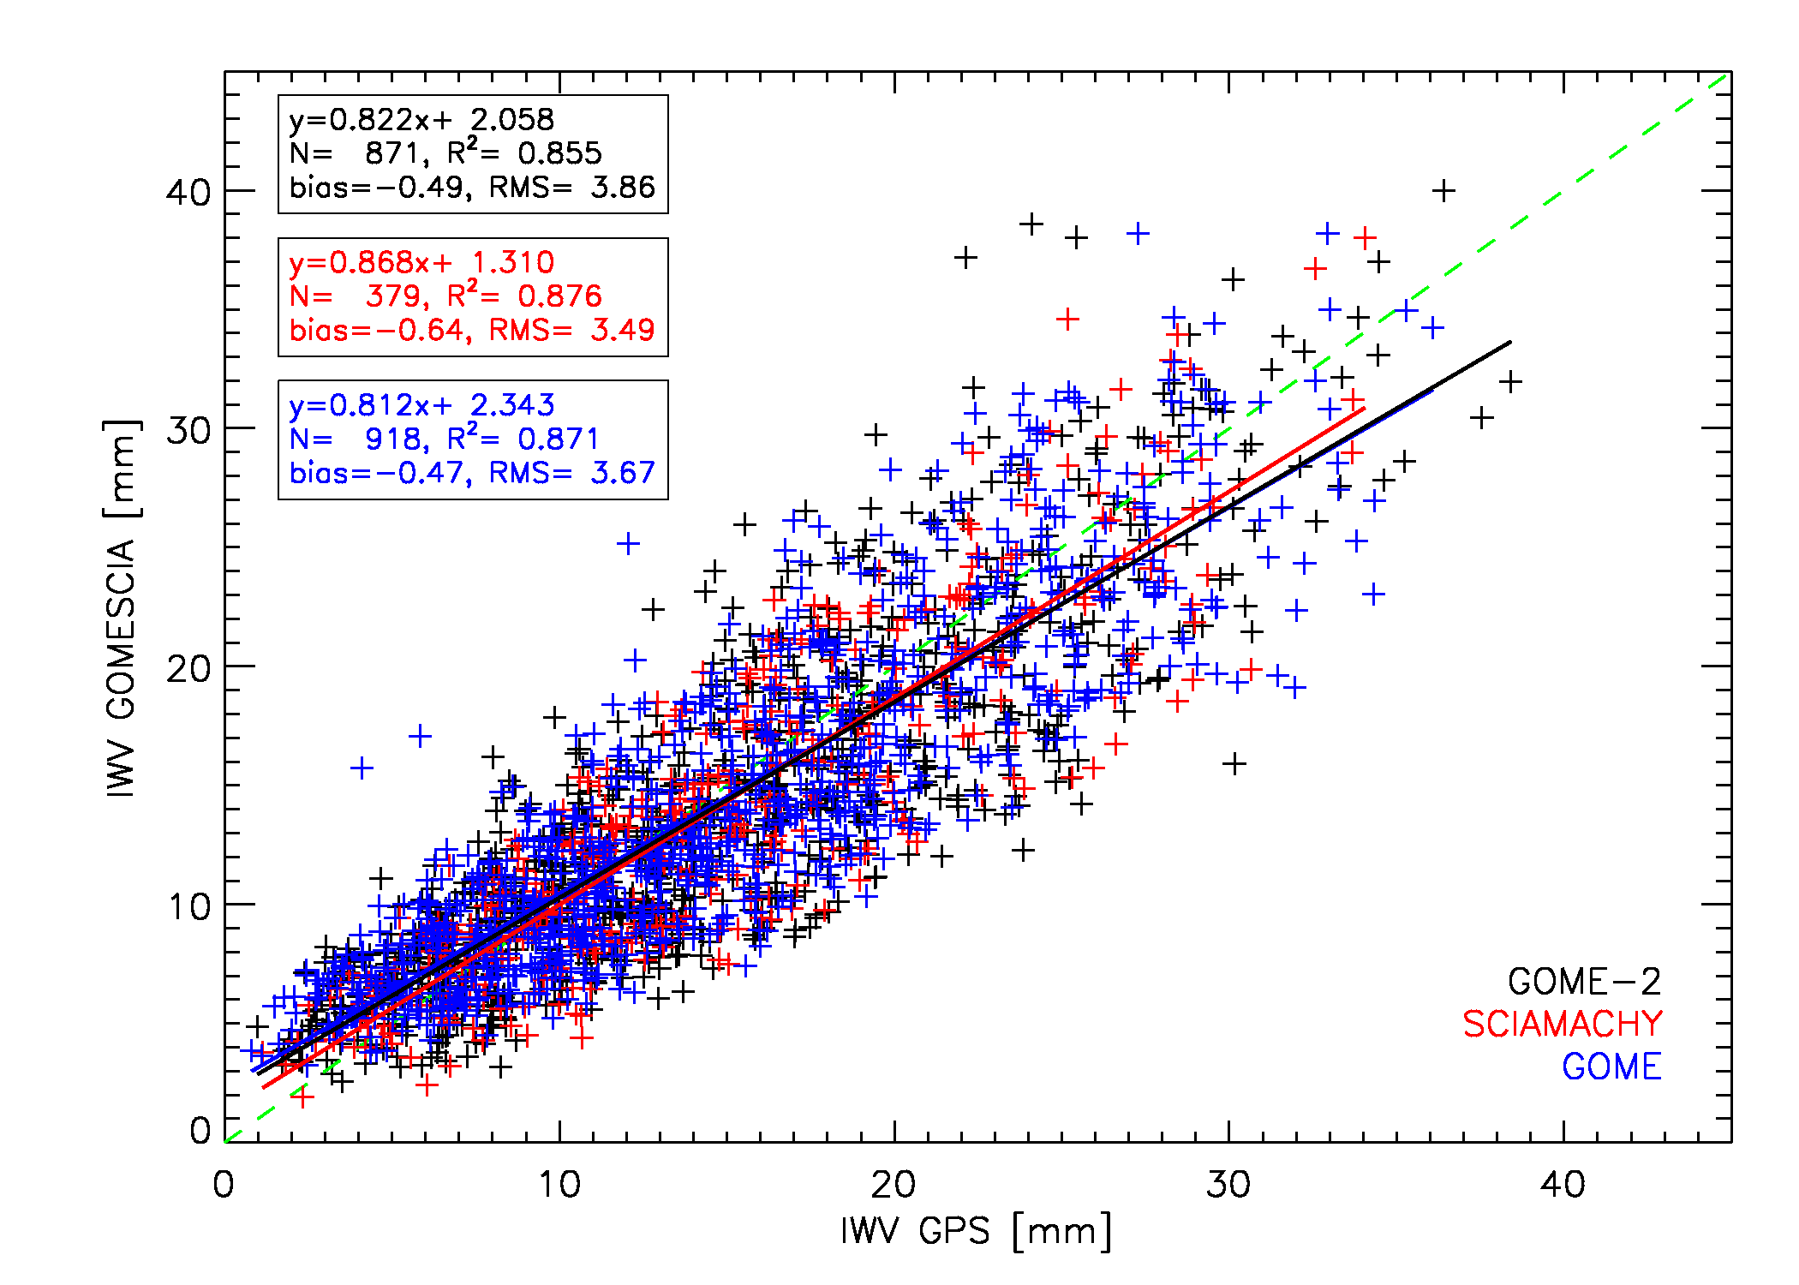
Instruments & datasets
Sensitivity analysis
Spatio-temporal variations
Conclusions
ROB
“GOMESCIA” ???
Brussels
“GOMESCIA” can be treated as one database, despite pixel size differences
MPI-C retrieval with instrument dependent offsets seems to work well
conclusion also valid for other stations
EUMETSAT/AMS conf. Vienna, 16-20 Sept. 2013

Slide 9
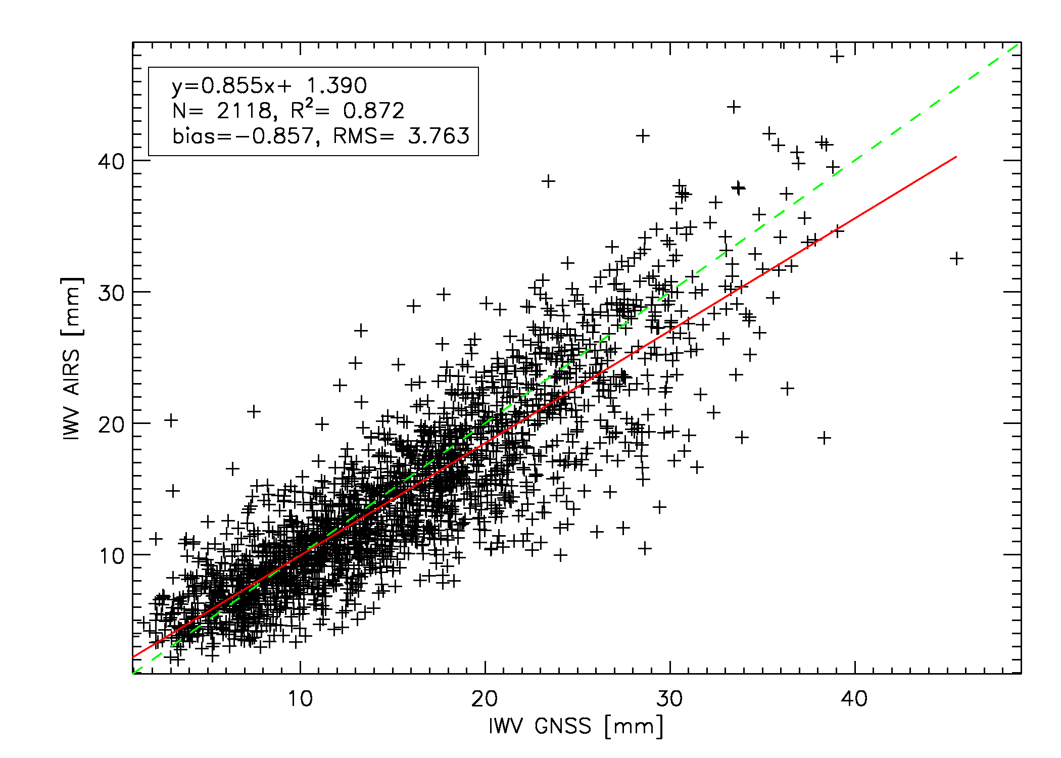
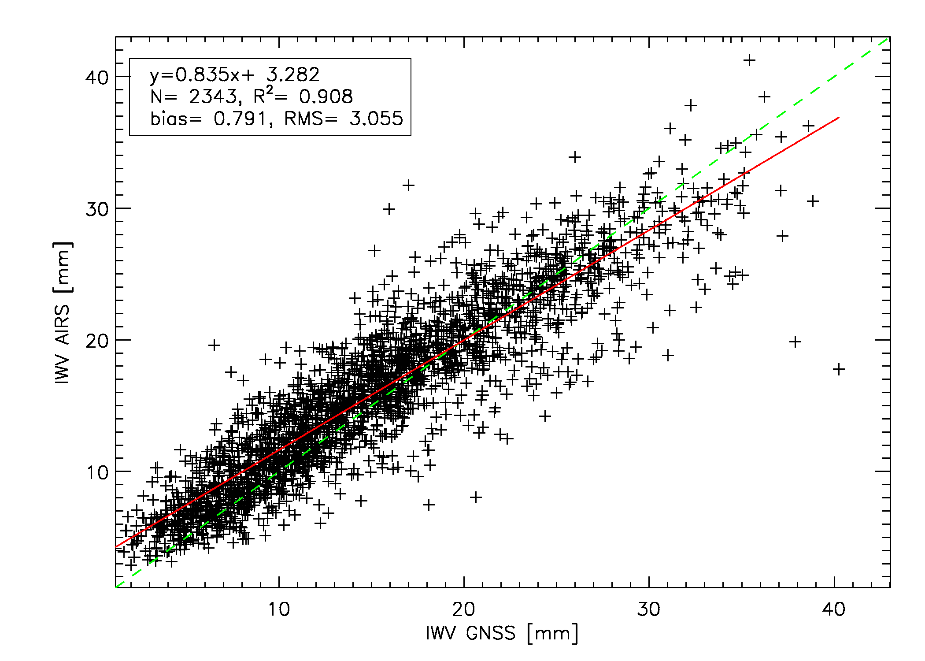
Instruments & datasets
Sensitivity analysis
Spatio-temporal variations
Conclusions
ROB
Day-night difference (AIRS)
day
Brussels
night
IWV GPS [mm]
IWV GPS [mm]
night-time AIRS retrievals show better agreement with GPS (higher R², lower RMS)
night-time retrievals have positive bias, daytime negative bias
daytime retrievals have higher regression slopes
EUMETSAT/AMS conf. Vienna, 16-20 Sept. 2013
conclusion also valid for other stations

Slide 10
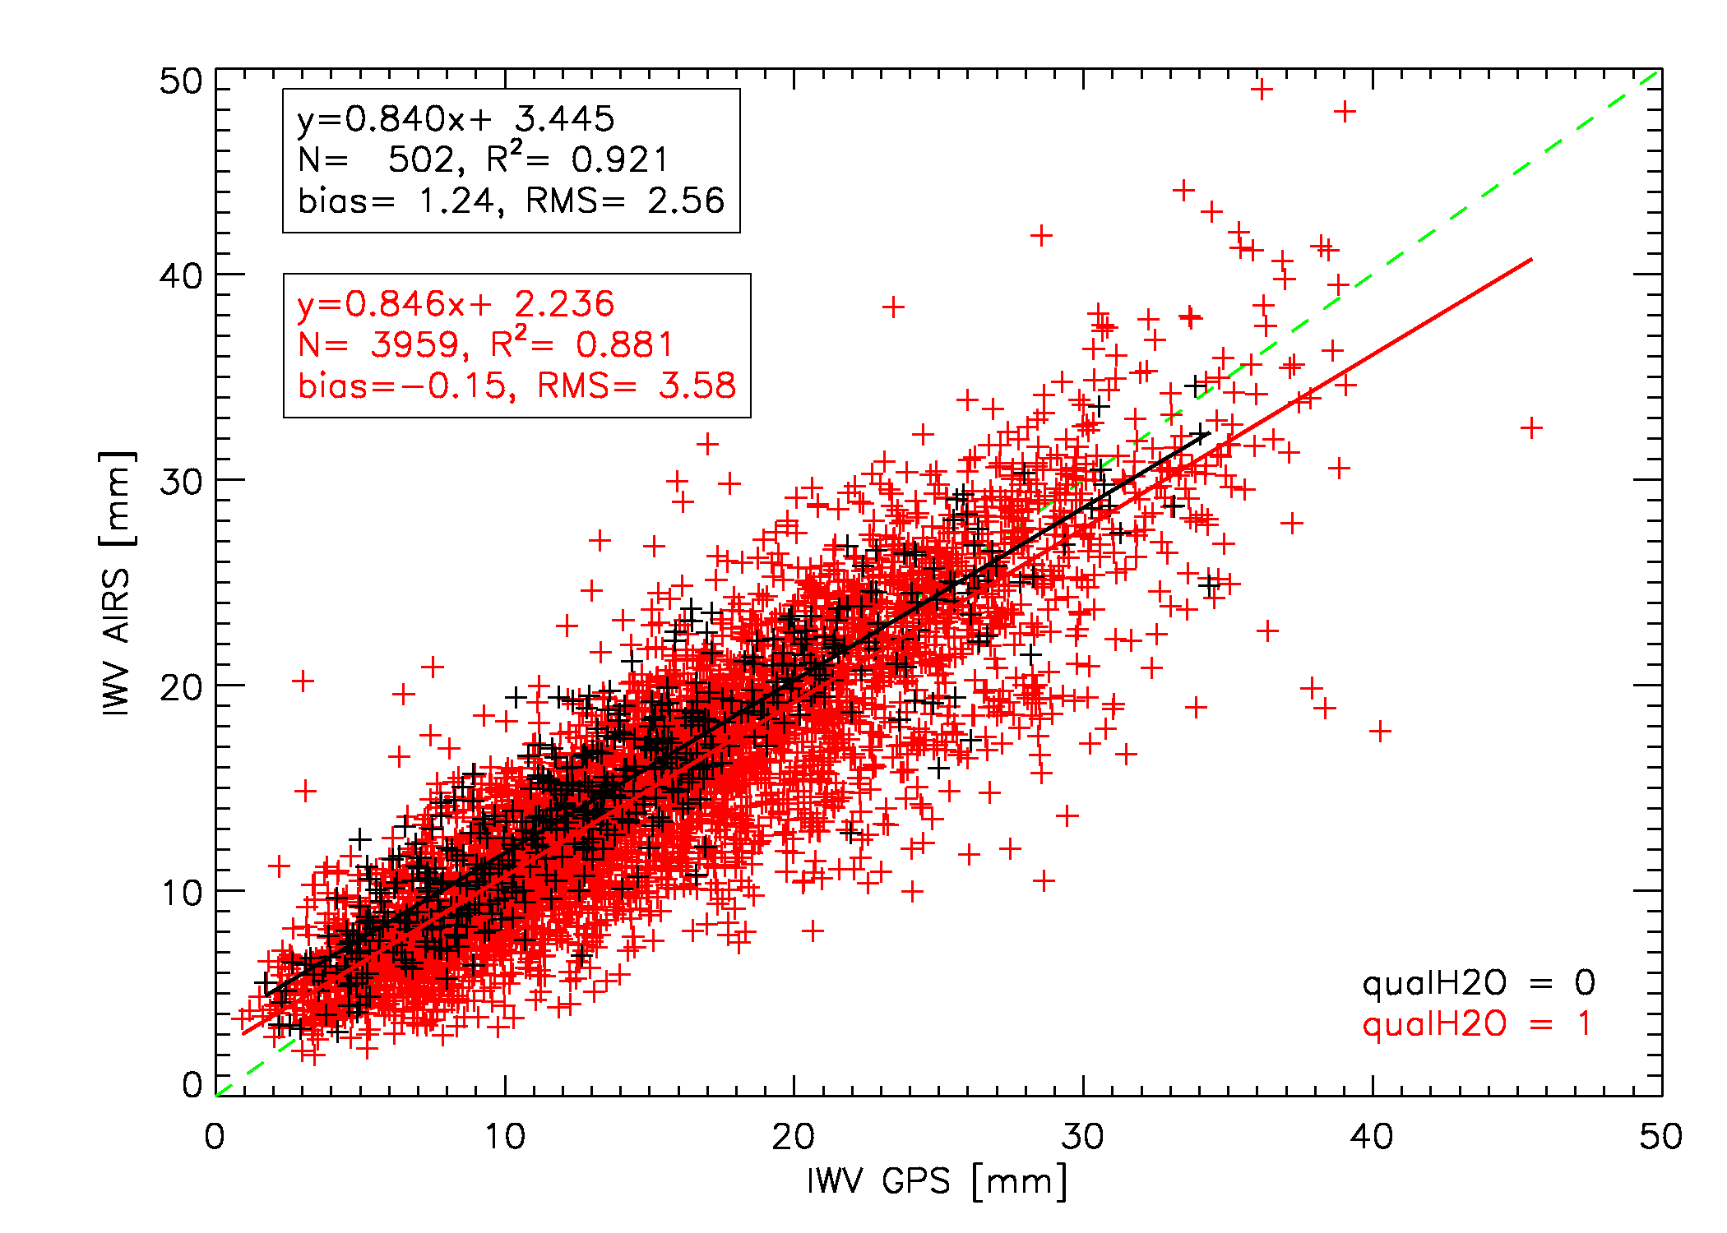
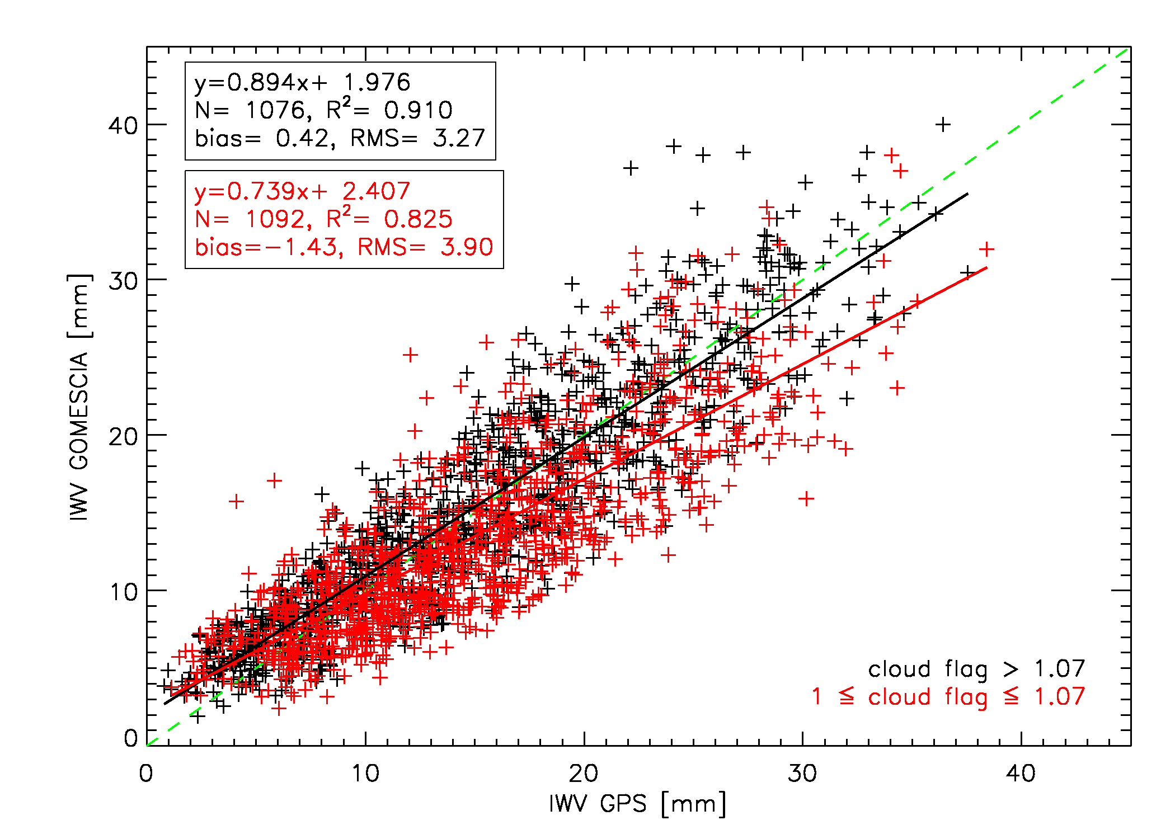
Instruments & datasets
Sensitivity analysis
Spatio-temporal variations
Conclusions
ROB
Cloud cover impact
GPS-AIRS
Brussels
GPS-GOMESCIA
p_{best} = p_{surf} ➔ clear sky
p_{best} < 300hPa ➔ cloud cover
cloud flag ↗ → O₂ column density ↗ → clearer sky
cloud cover ↗ → correlation coefficients ↘, bias ↘ (overestimation → underestimation), RMS ↗, regression slope ↘ only for GOMESCIA
EUMETSAT/AMS conf. Vienna, 16-20 Sept. 2013
conclusion also valid for other stations

Slide 11
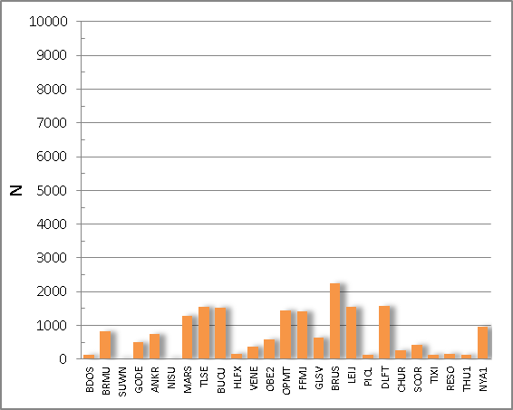
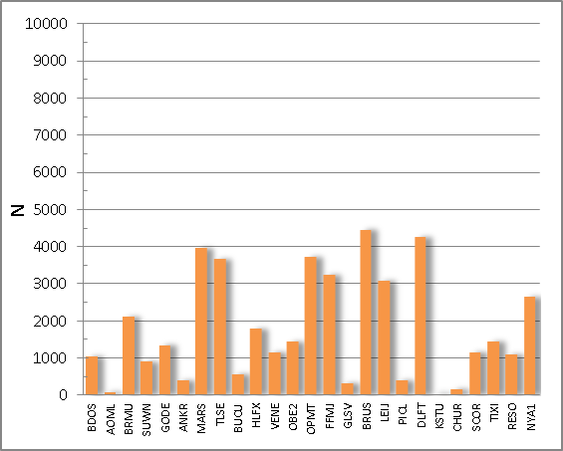
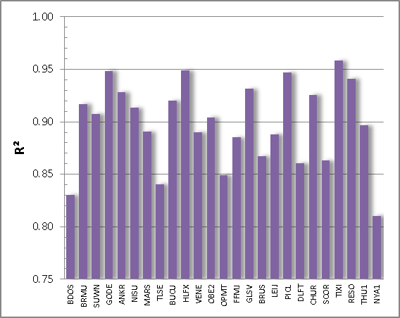
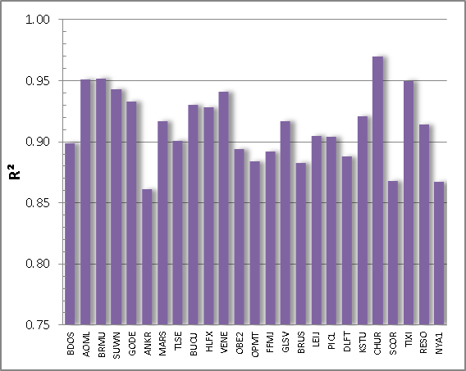
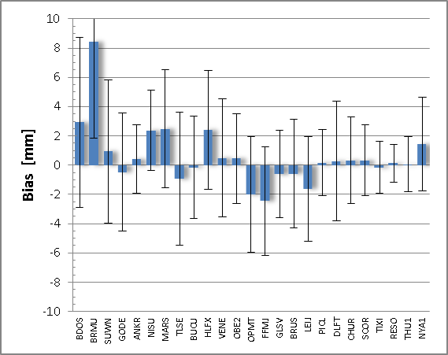
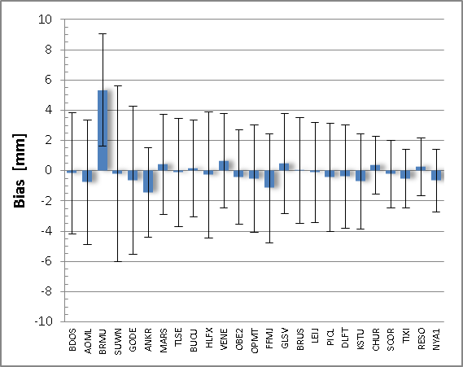
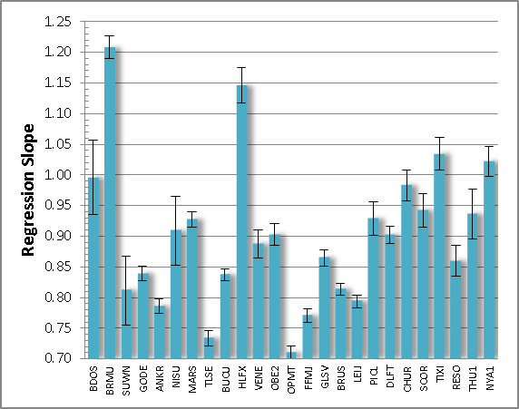
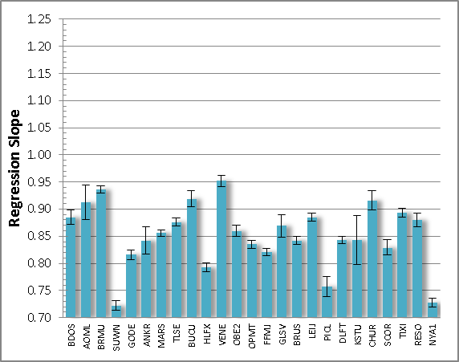
Instruments & datasets
Sensitivity analysis
Spatio-temporal variations
Conclusions
ROB
Geographical variations
GPS - GOMESCIA
GPS - AIRS
GPS - GOMESCIA
GPS - AIRS
scatter plot properties for the 28 co-locations, ordered with increasing latitude from left to right
geographical dependency? → only for RMS
EUMETSAT/AMS conf. Vienna, 16-20 Sept. 2013

Slide 12
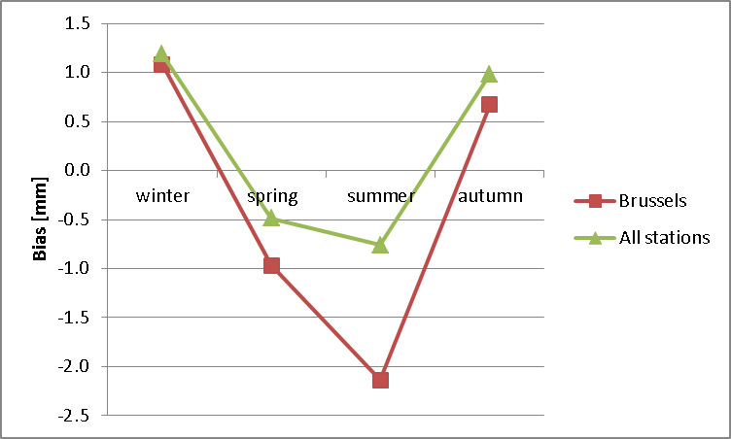
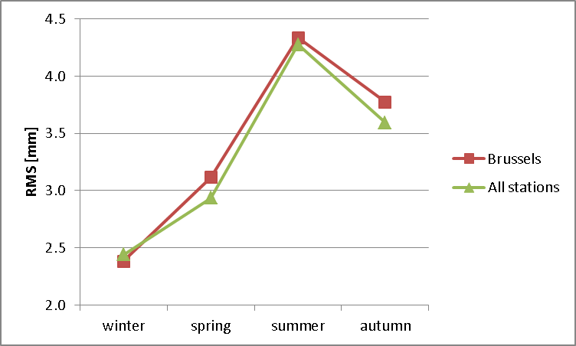
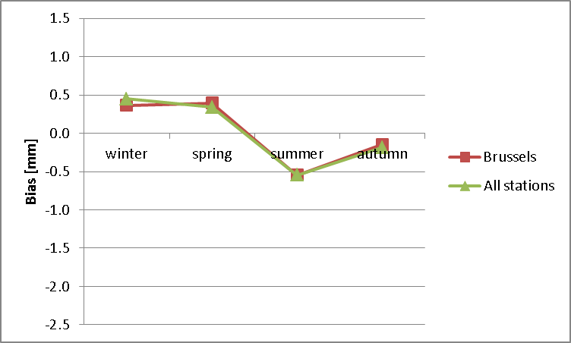
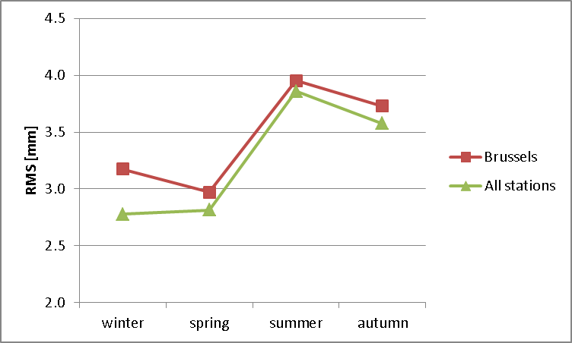
Instruments & datasets
Sensitivity analysis
Spatio-temporal variations
Conclusions
ROB
Seasonal variation
GPS-GOMESCIA
GPS-AIRS
EUMETSAT/AMS conf. Vienna, 16-20 Sept. 2013

Slide 13
Instruments & datasets
Sensitivity analysis
Spatio-temporal variations
Conclusions
ROB
Seasonal variation
bias minimal for maximum mean IWV (summer) and maximal for minimum mean IWV (winter) ? → different “sensitivities” of GPS and satellite sensors at the IWV → extremes
RMS maximal for maximum mean IWV and minimal for minimum mean IWV → consistent with latitudinal variation → in the presence of strong humidity gradients (moister air involved) → location and sampling differences might be more significant
EUMETSAT/AMS conf. Vienna, 16-20 Sept. 2013

Slide 14
Instruments & datasets
Sensitivity analysis
Spatio-temporal variations
Conclusions
ROB
Conclusions
although originally tracing other slants/directions, good agreement between GPS and satellite devices
Cloud cover is certainly an issue for satellite IWV retrievals, use of cloud flag data is essential for good agreement with GPS!
day-night differences in the AIRS IWV retrieval
Homogeneity of “GOMESCIA” database (1995-2011) seems OK for our purposes.
only for RMS of GPS-satellite scatter plots: seasonal and latitudinal dependency (RMS ∝ mean IWV)
submitted to ACP
EUMETSAT/AMS conf. Vienna, 16-20 Sept. 2013

