Slide 1
On instrumental errors and related correction strategies of ozonesondes: possible effect on calculated ozone trends for the nearby sites Uccle and De Bilt
R. Van Malderen¹, M.A.F. Allaart², H. De Backer¹, H.G.J. Smit³, D. De Muer¹
1
2
3

Slide 2
Testing the SI²N Ozonesonde Data Quality Assessment for the nearby stations Uccle and De Bilt
R. Van Malderen¹, M.A.F. Allaart², H. De Backer¹, H.G.J. Smit³, D. De Muer¹
1
2
3

Slide 3
Outline
Motivation and introduction: O3S-DQA
The Uccle and De Bilt ozonesonde stations
Comparison of average ozone profiles
Comparison of vertical ozone trends
Conclusions

Slide 4
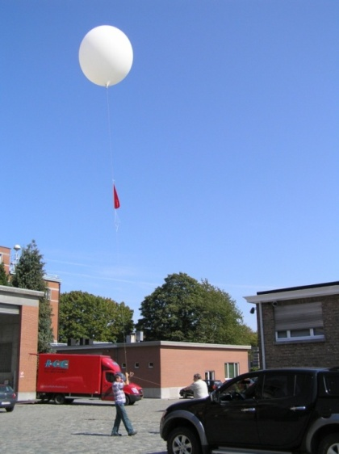
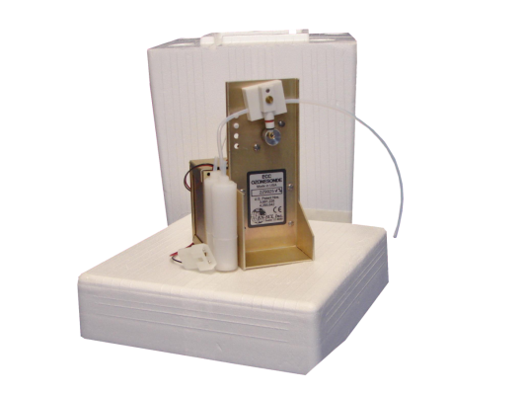
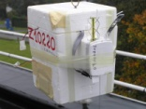
Motivation & introduction
Uccle & De Bilt
Average ozone profiles
Vertical ozone trends
Conclusions
Motivation
Most of you are familiar with …
Ozonesonde observations
around 60 sites worldwide
earliest operational launches around 1965 in Resolute
“the big three”: Hohenpeissenberg (1967), Uccle (1969), Payerne (1970)
e.g. De Bilt, only since Nov. 1992

Slide 5
Motivation & introduction
Uccle & De Bilt
Average ozone profiles
Vertical ozone trends
Conclusions
The pitfalls of ozonesonde time series:
different ozonesonde types (BM, KC, ECC)
different ECC ozonesonde type manufacturers (ENSCI/DMT, Science Pump)
differences between ozonesonde production batches
different operating procedures (e.g. measurement of background current, sensing solution/buffer strengths)
different post-processing correction algorithms (e.g. normalizing the profile to the total ozone measurements at the same site)
These differences occur both between sites and at one site!
➔ need for homogenisation (Ozonesonde Data Quality Assessment (O3S-DQA))

Slide 6
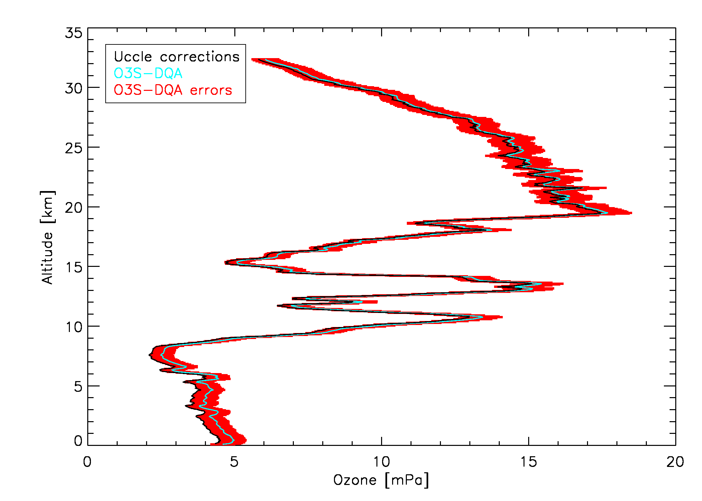
Motivation & introduction
Uccle & De Bilt
Average ozone profiles
Vertical ozone trends
Conclusions
O3S-DQA principles (only for ECC):
standard operating procedures
guidelines for metadata collection
two standards are set: ENSCI 0.5% SST & Science Pump 1% SST (ratio is 1.0 within 1%)
transfer functions to those standards, based on double soundings/simulation chamber experiments
standard correction algorithms
uncertainty estimate for every data point: (5-6% for Uccle ECC)
(revised) worldwide, homogenous,
consistent dataset to be used for
satellite validation and trend analysis
16/04/2012

Slide 7
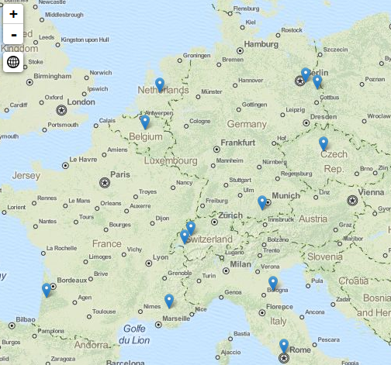
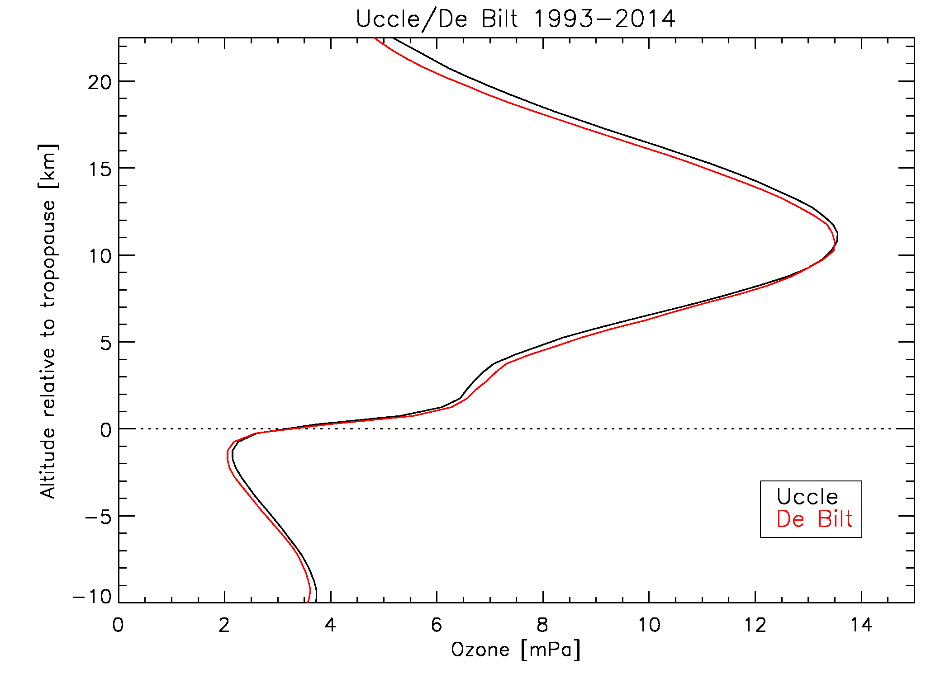
Motivation & introduction
Uccle & De Bilt
Average ozone profiles
Vertical ozone trends
Conclusions
Uccle and De Bilt
only about 175 km from each other
horizontal ozone correlation lengths: 500 km (tropo), 1500 km (strato)
timescales of ozone autocorrelation: 1.5-3.5 days (tropo),2-6 days (strato)
(Liu et al. 2009, 2013)
each station represent one ECC standard
differences in operating procedures (e.g. background current measurement)
both stations apply operationally different correction strategies
unique testbed for the O3S-DQA corrections
impact of operating procedures and corrections on the (average) profile
impact of operating procedures and corrections on the trends!

Slide 8
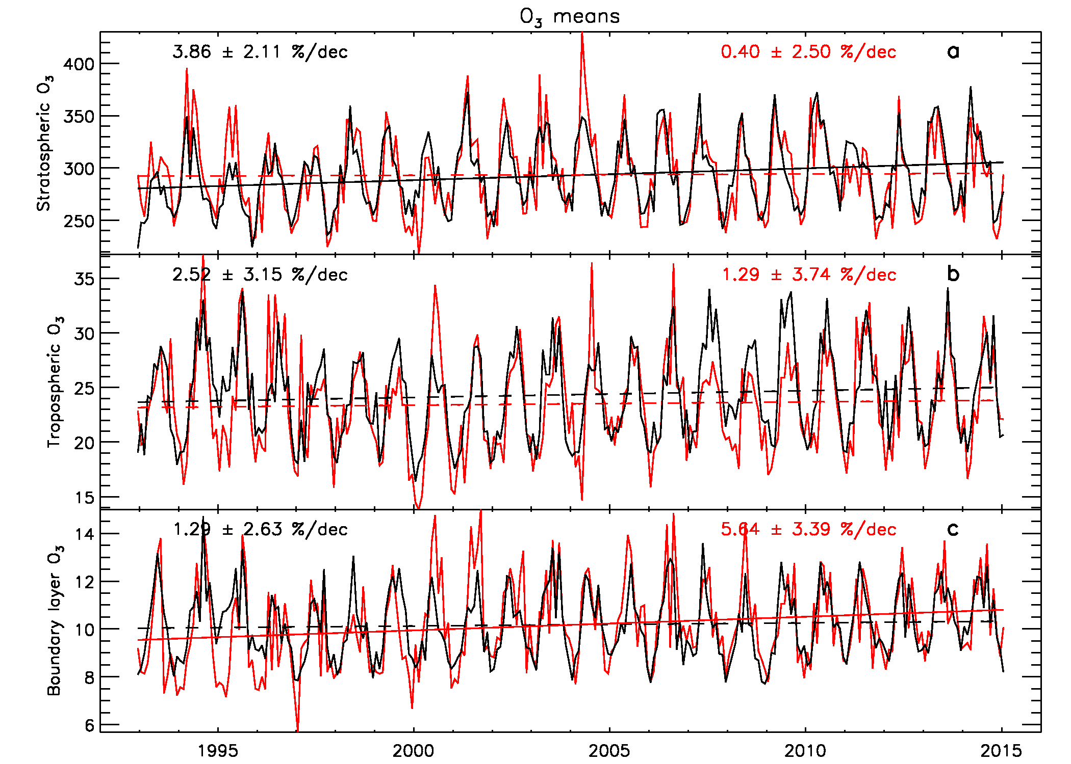
Motivation & introduction
Uccle & De Bilt
Average ozone profiles
Vertical ozone trends
Conclusions
Uccle and De Bilt
very similar time variability, at different atmospheric layers
larger spread at De Bilt due to lower frequency of launches
Uccle – De Bilt

Slide 9
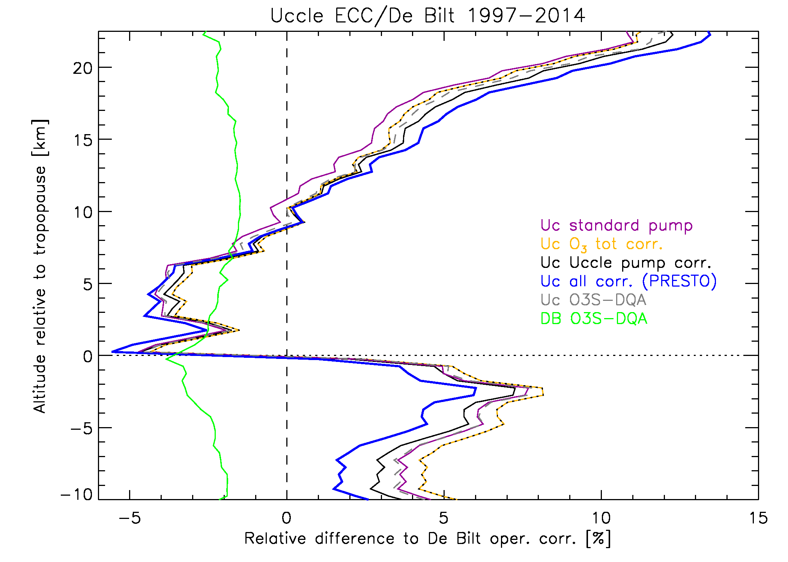
Motivation & introduction
Uccle & De Bilt
Average ozone profiles
Vertical ozone trends
Conclusions
Average ozone profiles
1997
+ average profiles calculated from the station’s ozone profiles corrected by alternative algorithms
“relative” differences = choose a reference average profile y
(x – y)/y * 100
differences between different Uccle correction strategies are within 3%, within 4% for De Bilt
O3S-DQA corrections: better agreement between Uccle and De Bilt only in lower stratosphere (below O₃ maximum)
O3S-DQA correction at Uccle: better agreement with De Bilt above O₃ maximum
Van Malderen, R. et al., Atmos. Meas. Tech. Discuss., doi:10.5194/amt-2015-341, in review, 2016.

Slide 10
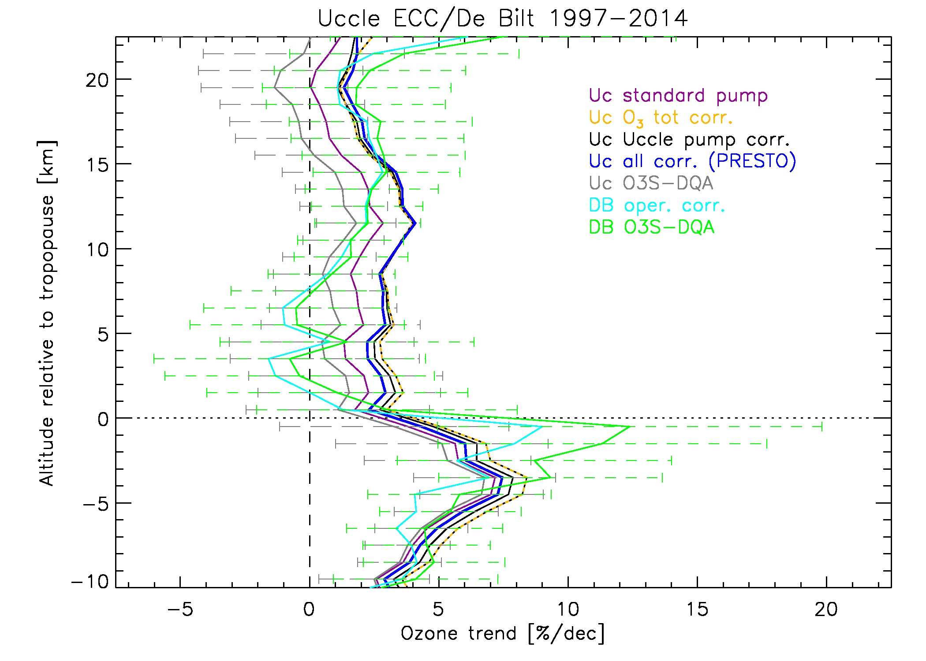
Motivation & introduction
Uccle & De Bilt
Average ozone profiles
Vertical ozone trends
Conclusions
Vertical ozone trends
trend differences between different Uccle correction strategies are within 3%/dec (UStr), within 4%/dec for De Bilt (UTr)
O3S-DQA corrections: better agreement between Uccle and De Bilt trends in LStr and LTr, but not significantly different!
O3S-DQA corrections: lower trends in Uccle, higher trends in De Bilt!
differences between different Uccle correction strategies are within 3%, within 4% for De Bilt
O3S-DQA corrections: better agreement between Uccle and De Bilt only in lower stratosphere (below O₃ maximum)
O3S-DQA correction at Uccle: better agreement with De Bilt above O₃ maximum
Van Malderen, R. et al., Atmos. Meas. Tech. Discuss., doi:10.5194/amt-2015-341, in review, 2016.

Slide 11
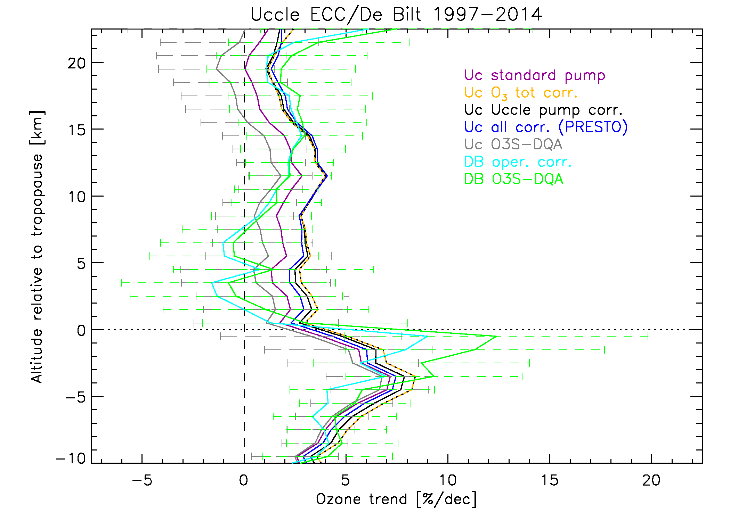
Motivation & introduction
Uccle & De Bilt
Average ozone profiles
Vertical ozone trends
Conclusions
Vertical ozone trends
Ozone recovery?
period starts with maximum peak value in EESC (1997)
only in troposphere: O₃ trends significantly different from zero!
sign of the O₃ trend in the strato-sphere depends on the station and on the applied data processing!
➔ caution is needed when using → terminology like “the onset of ozone → recovery!”
trend differences between different Uccle correction strategies are within 3%/dec (UStr), within 4%/dec for De Bilt (UTr)
O3S-DQA corrections: better agreement between Uccle and De Bilt trends in LStr and LTr, but not significantly different!
O3S-DQA corrections: lower trends in Uccle, higher trends in De Bilt!
Van Malderen, R. et al., Atmos. Meas. Tech. Discuss., doi:10.5194/amt-2015-341, in review, 2016.

Slide 12
Motivation & introduction
Uccle & De Bilt
Average ozone profiles
Vertical ozone trends
Conclusions
Conclusions
To serve the climate and satellite communities, an international ozonesonde data quality assessment activity was initiated.
The close ozonesonde stations Uccle and De Bilt provide a unique testbed for this homogeneity activity.
Still, natural differences in the vertical distribution of ozone between Uccle and De Bilt are likely to occur (→ needs more investigation!).
The O3S-DQA corrections do not give an overall better agreement of the average profiles and trends between both stations.
The impact of the correction strategies on the trends can make the difference between the onset of ozone recovery or not.

Slide 13
Thank you for your attention
More details:
Van Malderen R., Allaart M.A.F., De Backer H., Smit H.G.J. and De Muer D., Atmos. Meas. Tech. Discuss., doi:10.5194/amt-2015-341, in review, 2016.

Slide 14
Extra slides

Slide 15
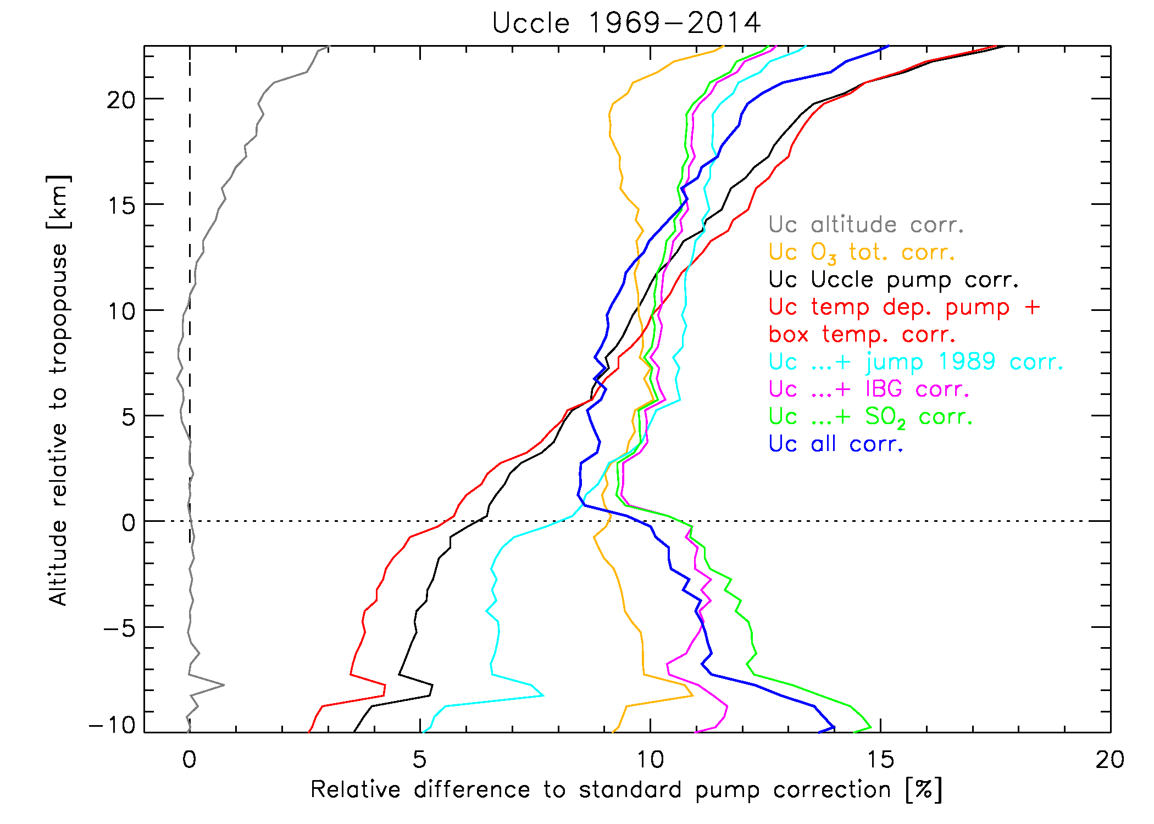
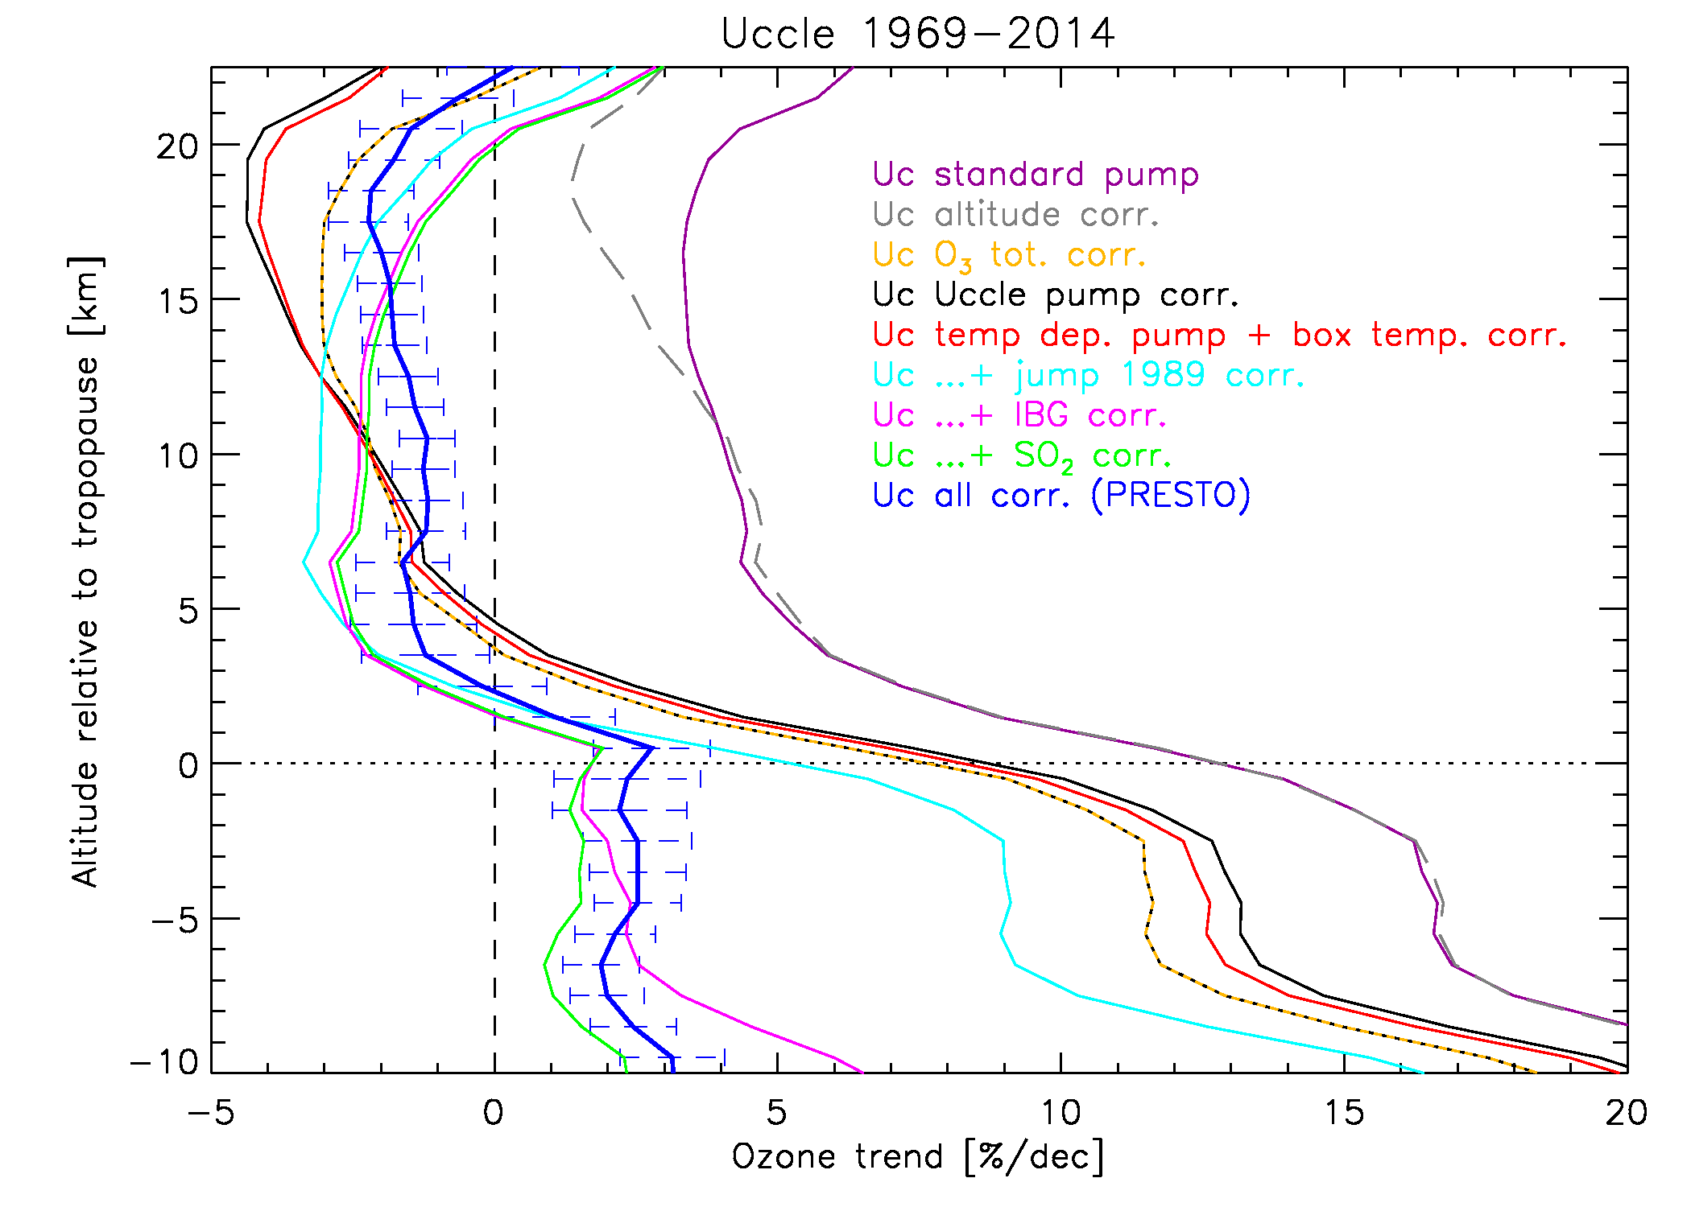
Average ozone profiles Vertical ozone trends
large differences between the different Uccle correction steps
final Uccle correction (BM+ECC) gives differences of 8-15% compared to standard pump correction only
strong reduction of the vertical trends by the final Uccle correction w.r.t. the standard pump corrections
final Uccle correction are fairly constant and consistent: +2 to +3 % dec⁻¹ in troposphere, -1 to -2 % dec⁻¹ in stratosphere
Van Malderen, R. et al., Atmos. Meas. Tech. Discuss., doi:10.5194/amt-2015-341, in review, 2016.

Slide 16
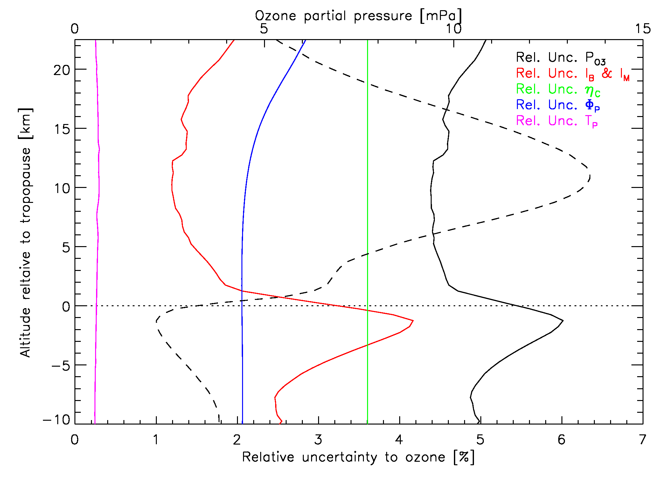
Average uncertainties of the Uccle O₃ profile

Slide 17
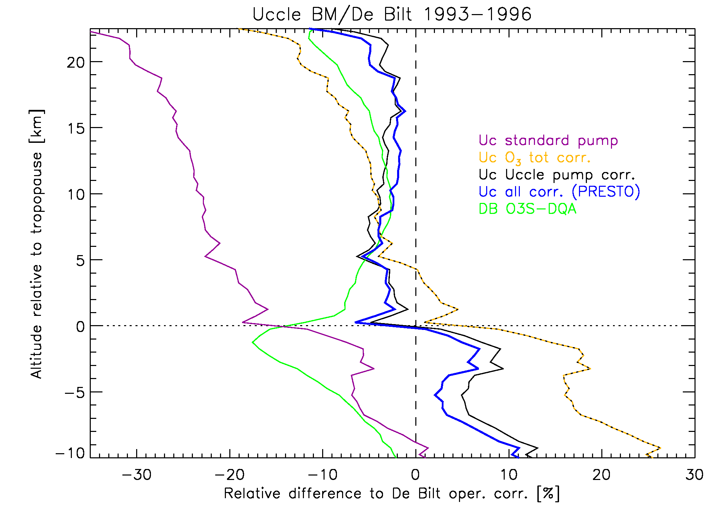
Motivation & introduction
Uccle & De Bilt
Average ozone profiles
Vertical ozone trends
Conclusions
Average ozone profiles
Uccle oper. corr. (blue) reduces O₃ differences to within 5%
BM sondes have a typical response equivalent to about 80% of the actual ozone amount
large differences (UT: >15%) between both De Bilt corrections
Van Malderen, R. et al., Atmos. Meas. Tech. Discuss., doi:10.5194/amt-2015-341, in review, 2016.

Slide 18
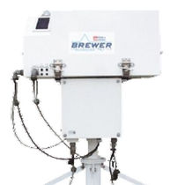
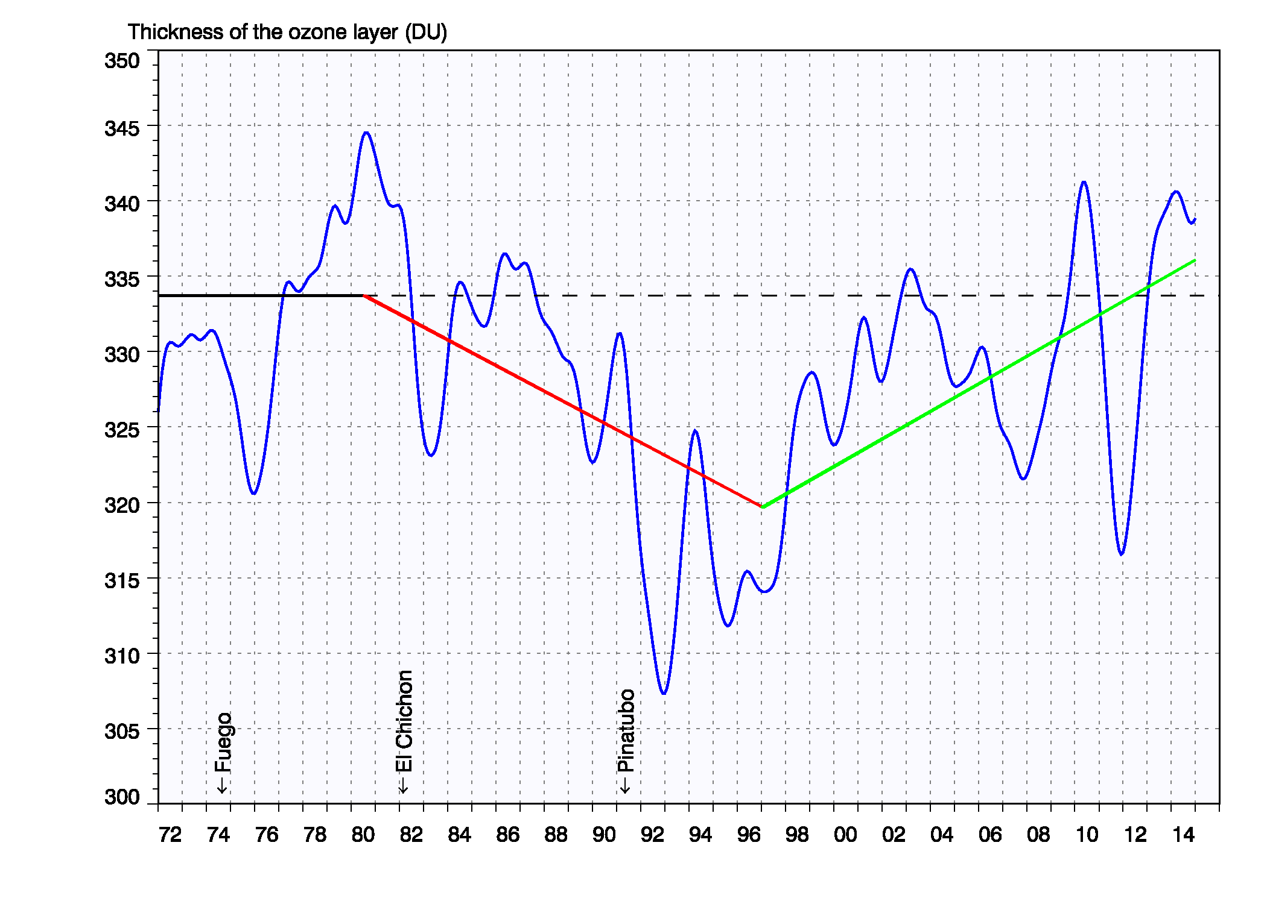
Total ozone trend at Uccle
O₃ ↘ -0.26±0.05 %/yr (1980-1996)
O₃ ↗ +0.28±0.05 %/yr (1997-2014)
full recovery at Uccle?
impact of volcanic eruptions on ozone!
other processes responsible for the O₃ time variability?

Slide 19
Sensing solution strengths (SST)

Slide 20
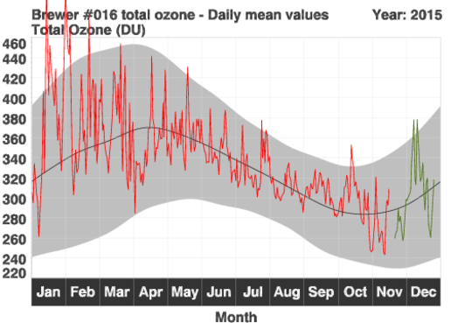
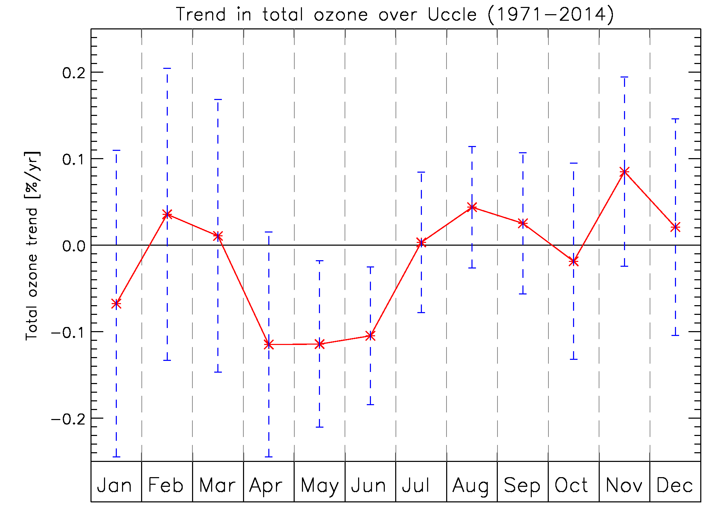
Total ozone seasonal variation
in general, highest values in spring, lowest values in fall
Total ozone monthly trends
only in late spring-early summer (Apr-June): significant negative trends in total ozone at Uccle
RMI conference 25/11/2015

Slide 21
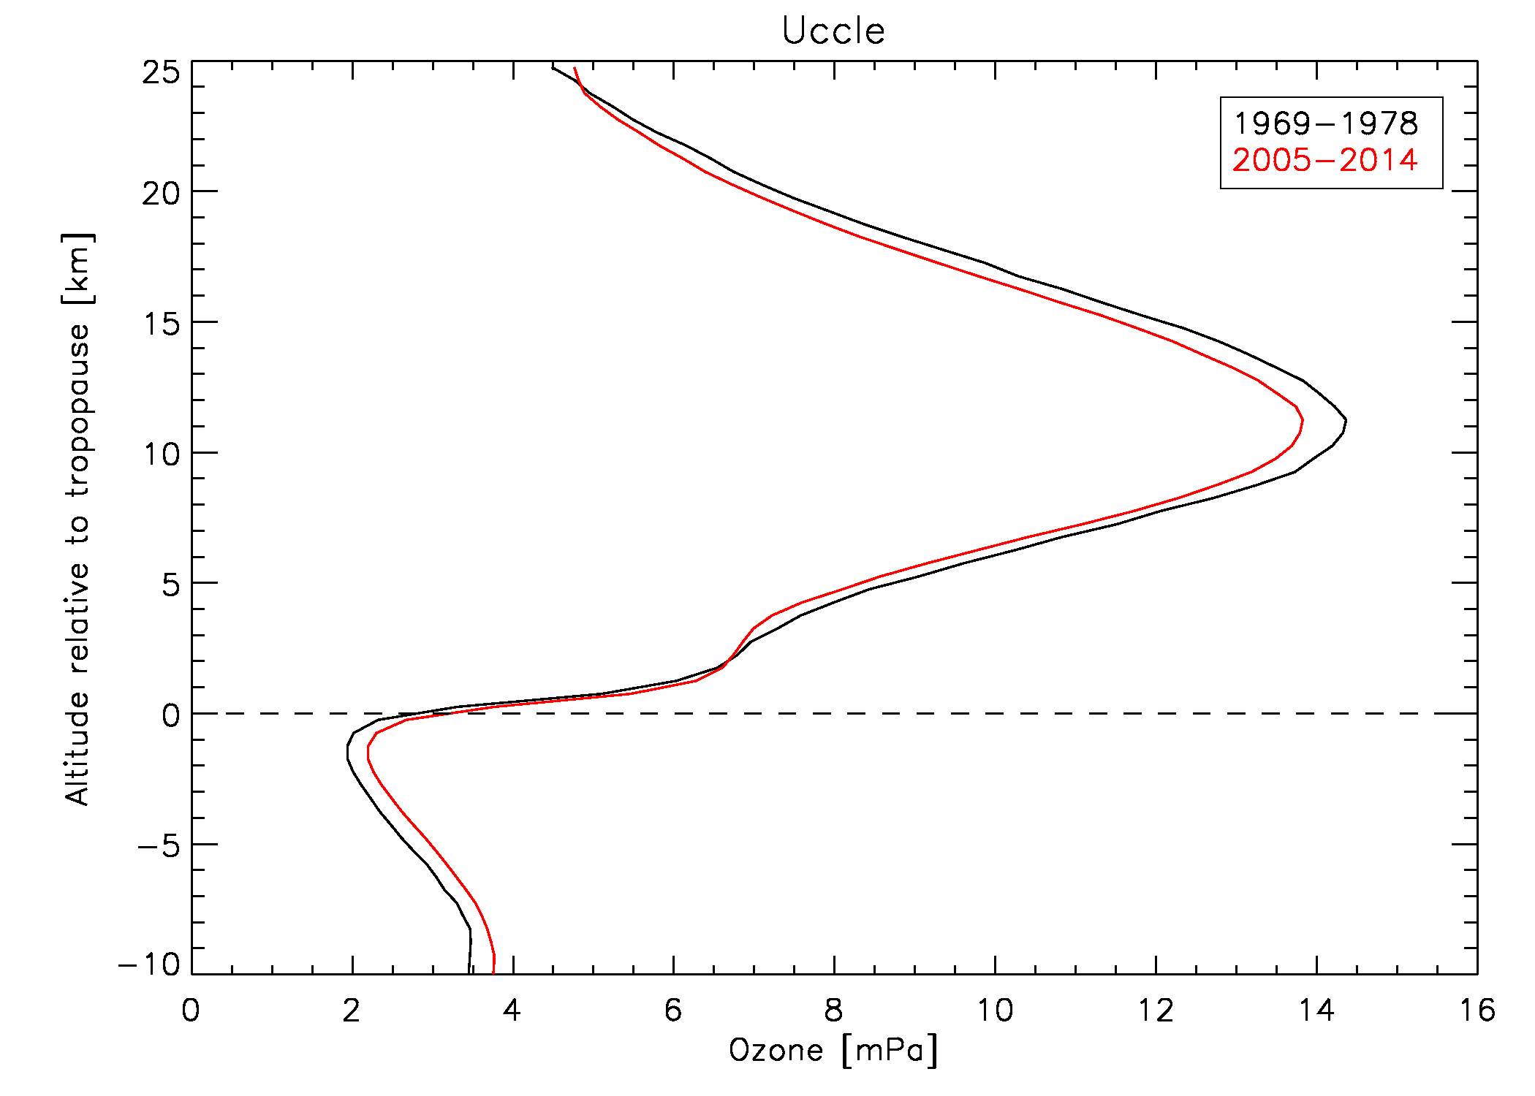
Vertical ozone distribution at Uccle
➔ stratospheric O₃ ↘
➔ tropospheric O₃ ↗
BUT: different periods = different ozonesonde types!
= BM & ECC

Slide 22
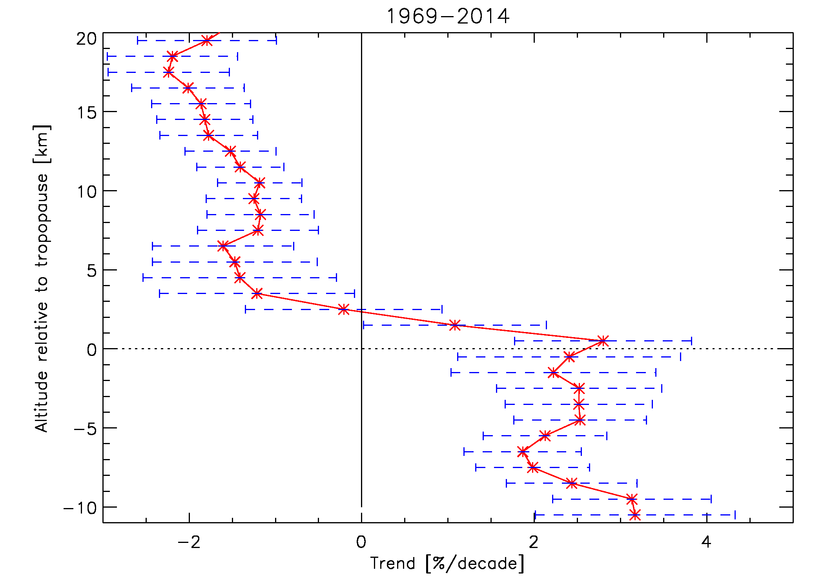
Vertical ozone distribution at Uccle
➔ stratospheric O₃ ↘
at around -2%/decade
➔ tropospheric O₃ ↗
at around +2%/decade
Impact of the different ozonesonde types on the trends?

